Slide 1
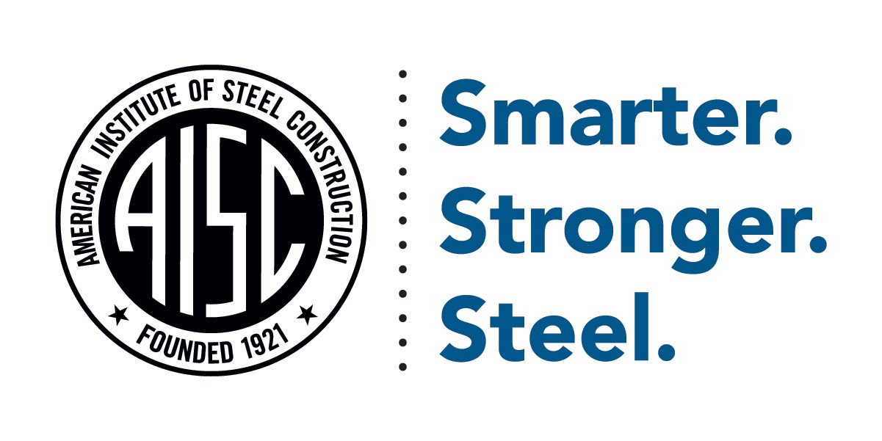
AISC Student Club
[school] club proposal

Slide 2
Who is AISC?
The American Institute of Steel Construction (AISC), headquartered in Chicago, is a non-partisan, not-for-profit technical institute and trade association established in 1921 to serve the structural steel design community and construction industry in the United States.

Slide 3
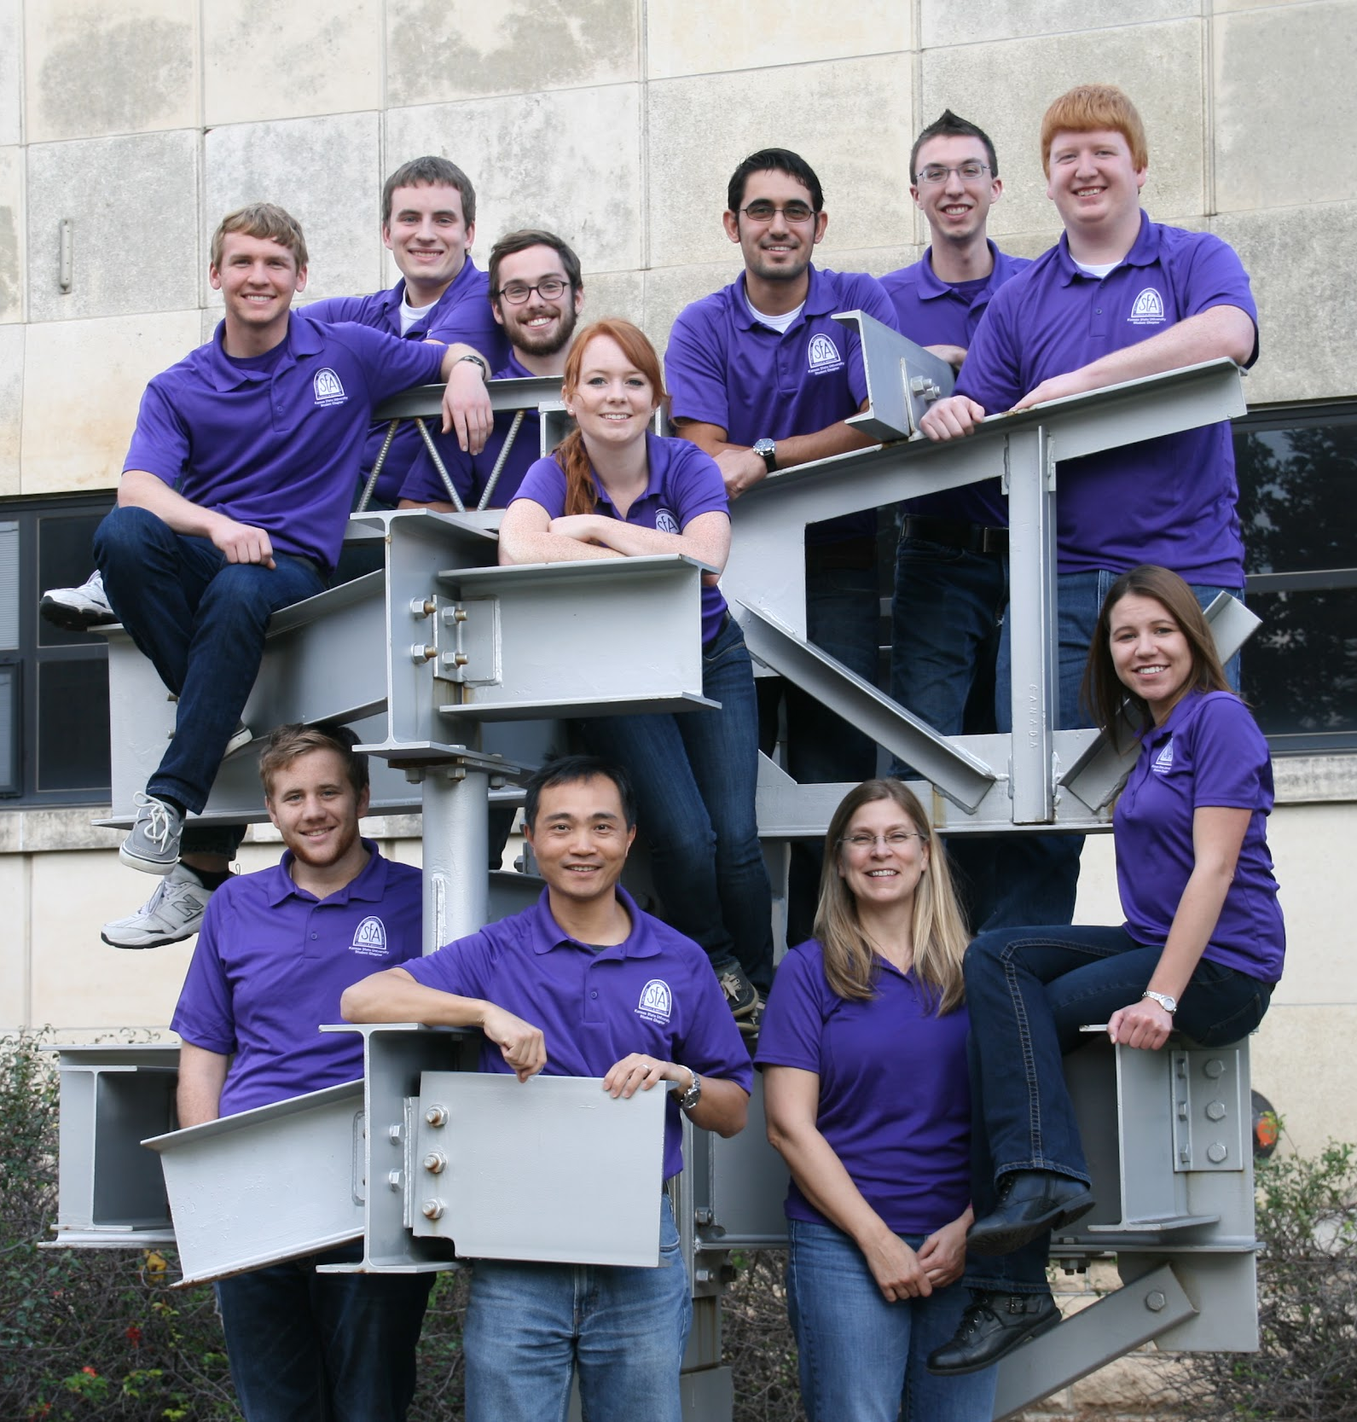
What is an AISC Student Club?
AISC offers college-level students a way to formally organize and develop a student organization that is recognized by AISC and the AISC Education Foundation.

Slide 4
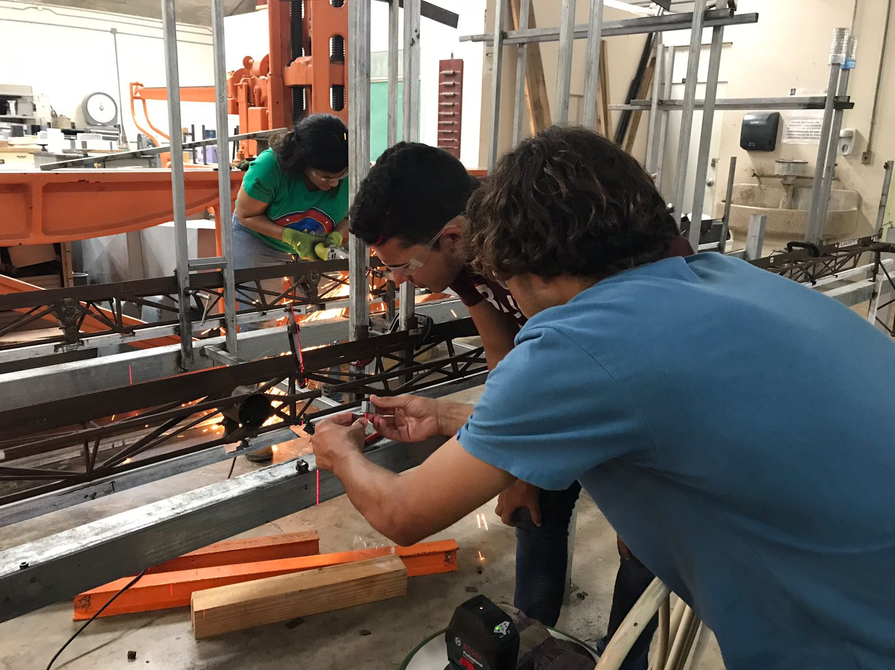
What is an AISC Student Club?
The AISC Student Clubs offer steel design and/or construction students the opportunity to gather on campus and meet as a group to:
Exchange steel-related knowledge
Engage in educational activities
Network with peers and industry representatives

Slide 5
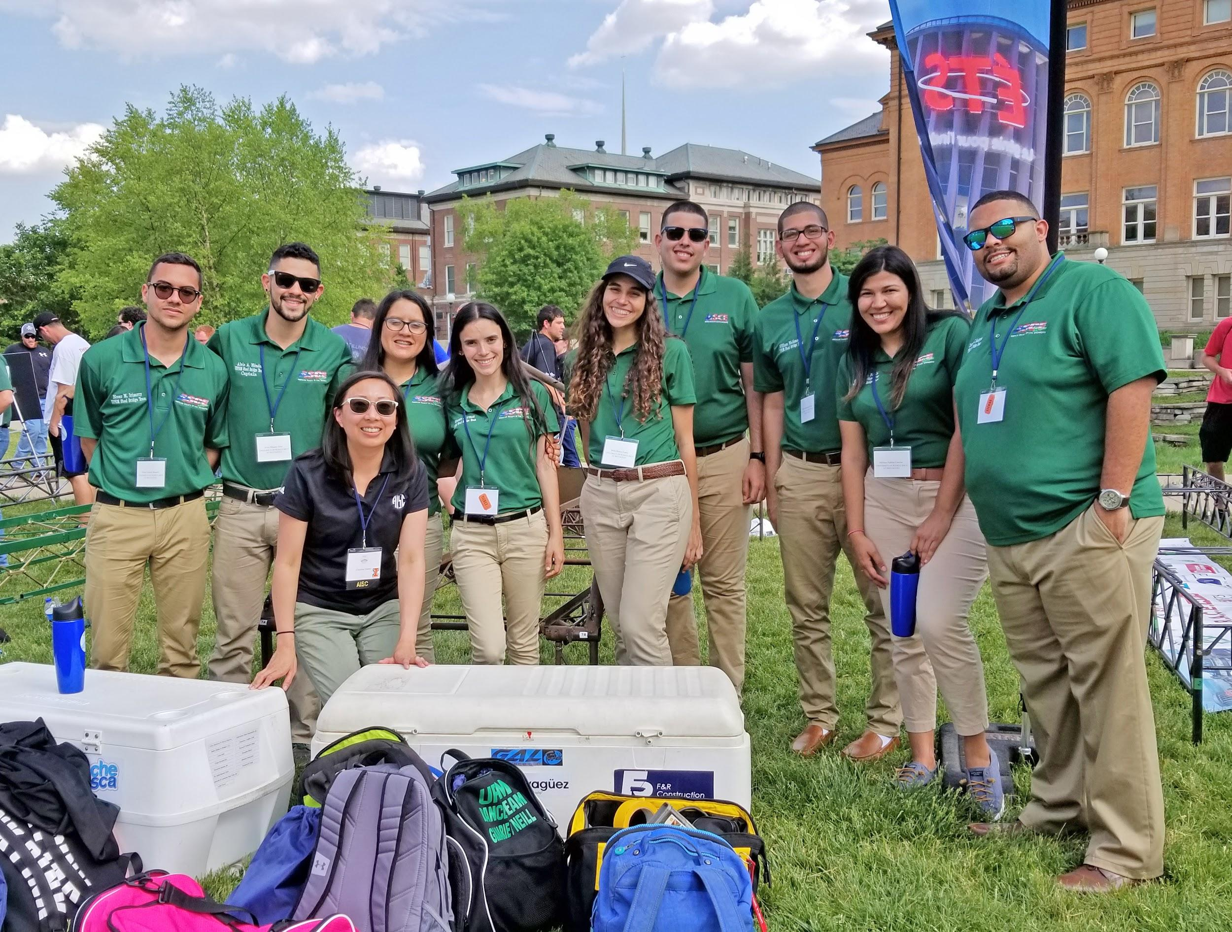
What is an AISC Student Club?
Additionally, AISC Student Clubs can be organized to:
Support the school’s Student Steel Bridge Competition (SSBC) team
Attend AISC’s NASCC: The Steel Conference as a group
Participate in AISC’s Adopt-a-School program

Slide 6
What is the Student Steel Bridge Competition?
2,500+ students 220+ schools across the country
18 regional competitions 40+ national finalists 1 national competition
Notes:
For the Student Steel Bridge Competition, each student team develops a concept for a scale-model steel bridge to span approximately 20 feet and to carry 2,500 pounds according to competition rules. Civil, architectural, and structural engineering students are challenged to an intercollegiate competition that supplements their education with a comprehensive, student-driven project experience from conception and design through fabrication, erection, and testing. This experience increases awareness of real world engineering issues and culminates in a steel structure that meets client specifications and optimizes performance and economy.

Slide 7
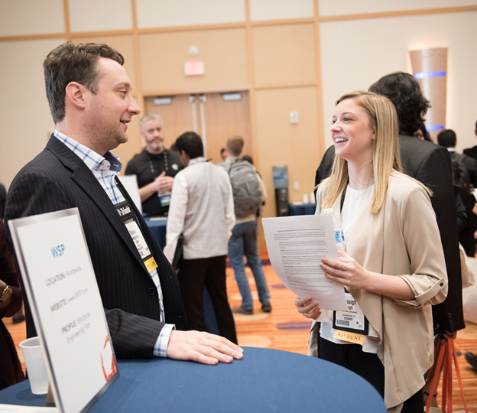
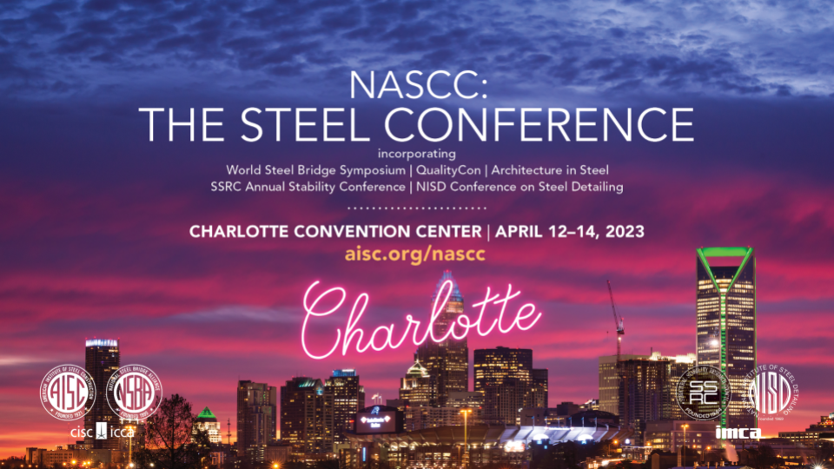
What is NASCC: The Steel Conference?
Students Connecting with Industry Sessions
Free registration for AISC Student Members
Travel reimbursement and meal benefits
Notes:
The Steel Conference is AISC’s annual premier conference event for engineers, fabricators, detailers, general contractors, erectors, educators, and students us to learn about structural steel design and construction, to interact with peers, and to see the latest products for steel buildings and bridges. The conference features three days packed with more than 130 technical sessions,, more than 240 exhibitors, plentiful networking opportunities, and special programs specifically designed for educators and students. AISC Student Members can register to attend The Steel Conference for free, and AISC provides additional travel reimbursement and meal benefits. Students are strongly encouraged to attend! Further details can be found at aisc.org/nascc.

Slide 8
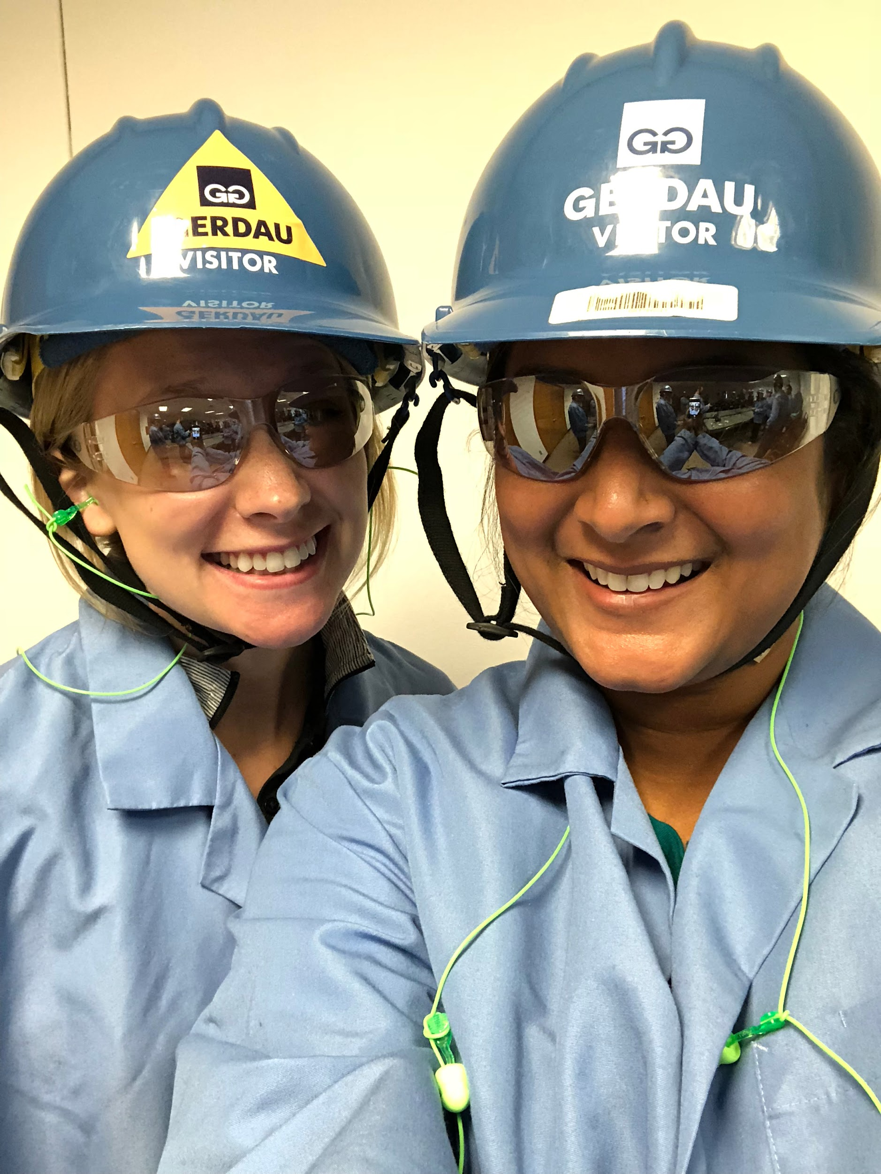
What is AISC’s Adopt-a-School Program?
Adopt-a-School matches steel fabricators with college faculty and students. The program encourages long-term relationships that can improve learning experiences both in and out of the classroom.
Opportunities include:
Shop tours
SSBC team sponsorships
Guest lecturers for Club meetings
Donated sample materials

Slide 9
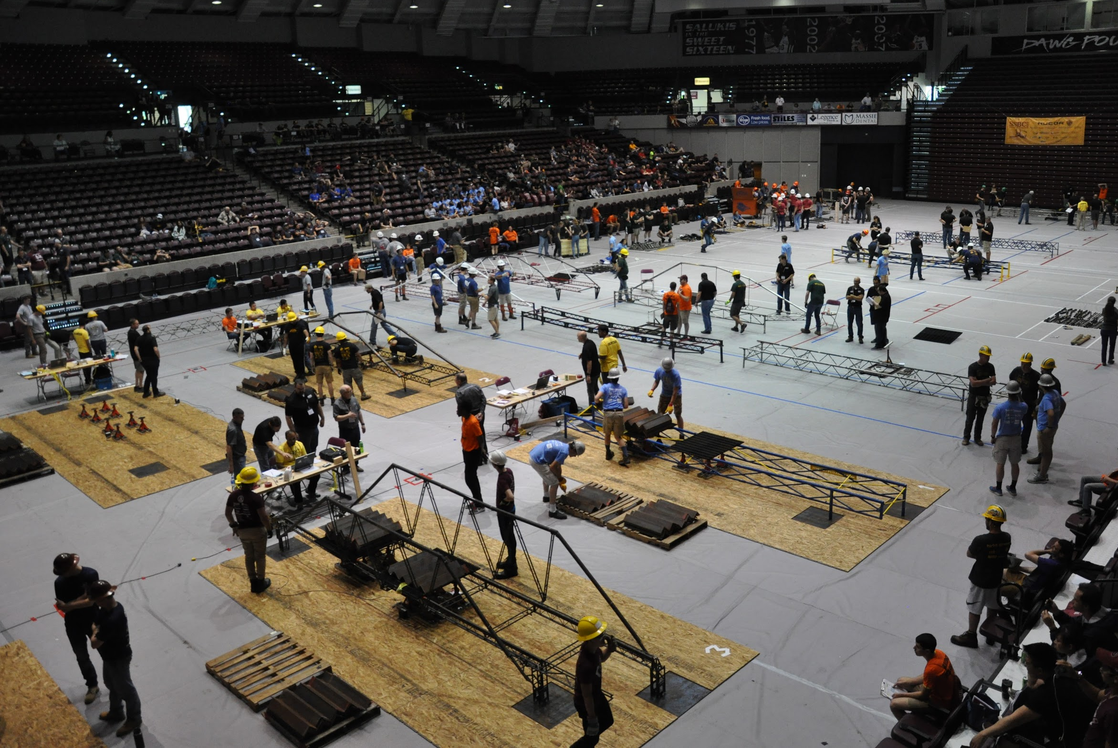
What are the benefits of affiliation with AISC?
Use of AISC’s IRS Employer Identification Number (EIN) to open a bank account and operate as a tax exempt entity.
Coverage under AISC’s insurance for club-related activities.
Connection to AISC’s vast member network and resources.
First to know about new student-oriented programs and other opportunities offered by AISC.

Slide 10
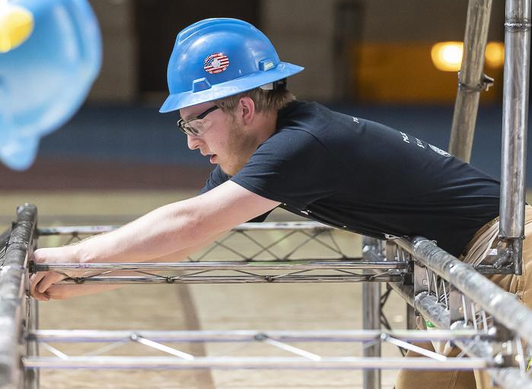
Why join an AISC Student Club?
[Steel related course(s)] are required as part of the [Major(s)] curriculum.
Participation in the AISC Student Club can extend classroom knowledge to practical, interactive, and hands-on experiences.
Notes:
** Notes to speaker: Personalize this slide to include any steel-related course(s) that are offered at your school and the respective department(s). Be sure to include both those that are required and those that may be offered as an elective!
For example: Structural Steel Design is required as part of the Civil Engineering curriculum and also offered as a technical elective for the Architectural Engineering curriculum.

Slide 11
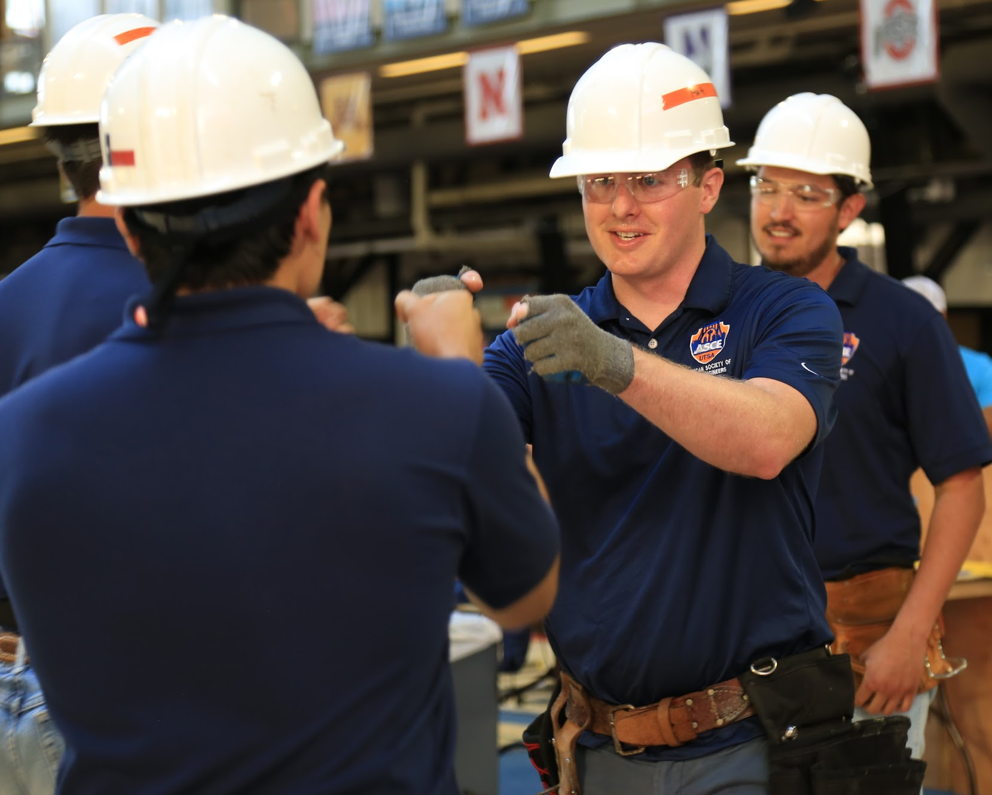
Why join an AISC Student Club?
Grow interpersonal, professional, and project management skills
Develop impactful relationships with industry professionals
Learn steel fabrication processes
Free registration to NASCC: The Steel Conference and other AISC education and networking events

