Slide 1
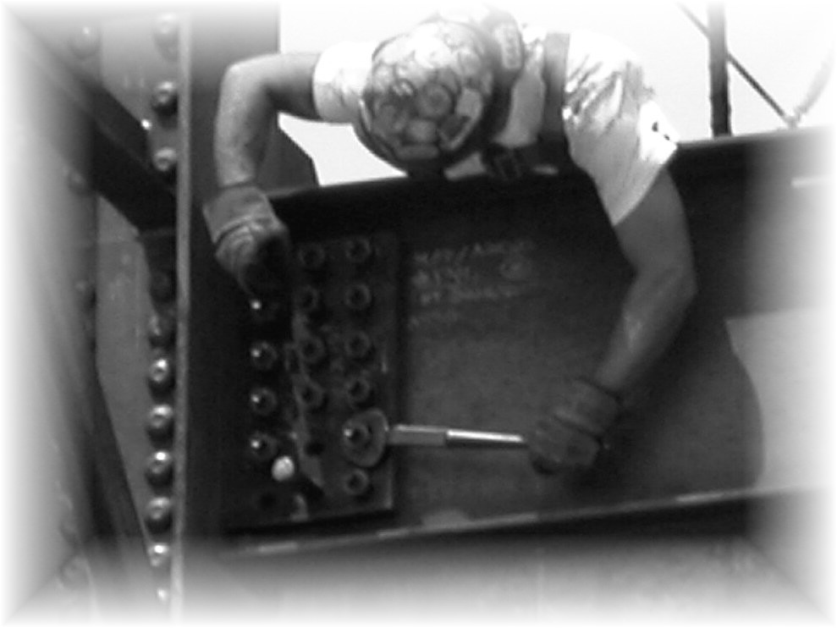
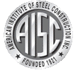
Bolting
and
Welding

Slide 2
Introduction
This presentation was developed as a teaching aid with the support of the American Institute of Steel Construction. Its objective is to provide technical background and information for bolting and welding. The information provided is based on common design and construction practices for structures of twelve stories or less.
The Four Story Building Case study presentations document the construction of a steel frame for an office building. The case study includes photographs that were taken throughout the construction of the structural steel frame including detailing, fabrication, and erection. Project data including plans, schedules, specifications and other details are also included. The case study presentations are available in the Teaching Aids section at www.aisc.org/universityprograms.
This presentation provides technical information on bolting and welding, as well as the impacts of details and design choices on schedule, cost, sequence and overall project management.
The information is presented with concerns of a construction manager or general contractor in mind.

Slide 3
What Will You Gain From This Presentation?
General knowledge of structural steel
An understanding of the different ways that structural steel is connected
Insight into types of bolts and their installation
An awareness of types of bolted joints used for structural steel
Knowledge of welding terminology, weld types, and welding processes
Familiarity with common weld inspection methods and considerations associated with field welding

Slide 4
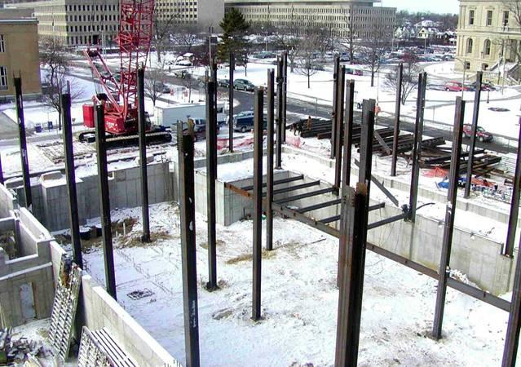
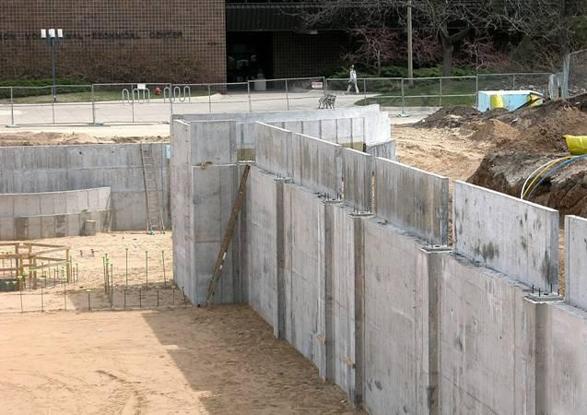
Benefits of Structural Steel
Some benefits associated with use of structural steel for owners are:
Steel allows for reduced frame construction time and the ability to construct in all seasons
Steel makes large spans and bay sizes possible, providing more flexibility for owners
Steel is easier to modify and reinforce if architectural changes are made to a facility over its life
Steel is lightweight and can reduce foundation costs
Steel is durable, long-lasting and recyclable

Slide 5
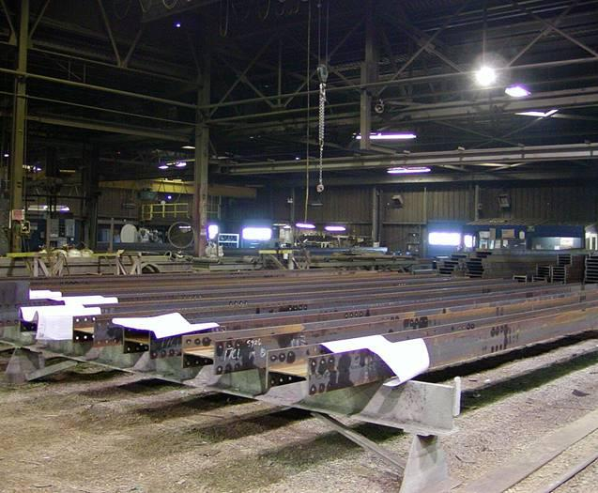
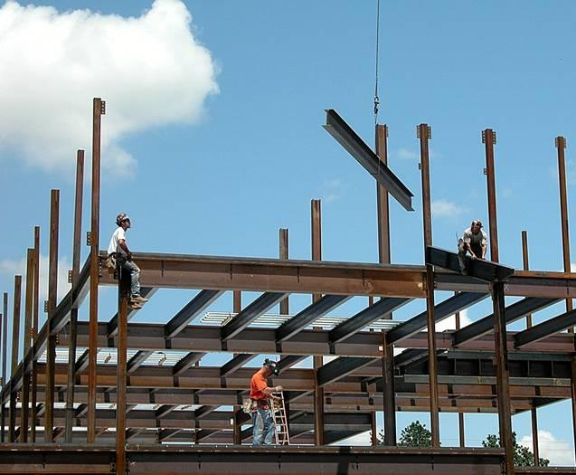
Unique Aspects of Steel Construction
Procurement and management of structural steel is similar to other materials, but there are some unique aspects to steel construction:
Steel is fabricated off-site (above left)
On-site erection is a rapid process (above right)
This gives use of structural steel some scheduling advantages
Coordination of all parties is essential for achieving potential advantages

Slide 6
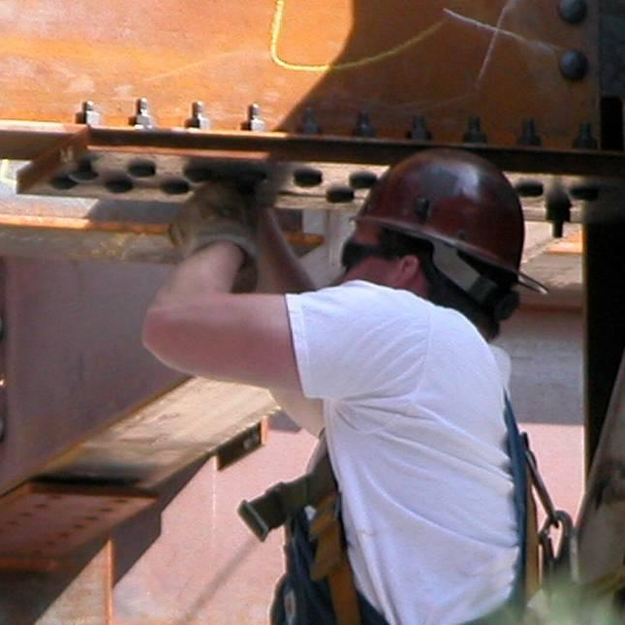
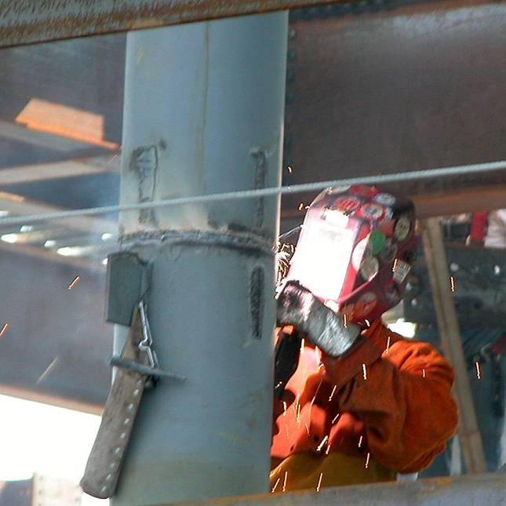
Connecting Structural Steel
The primary connection methods for structural steel are bolting and welding
A structure’s strength depends on proper use of these connection methods
Connections made in a fabrication shop are called shop connections
Connections made in the field by the steel erector are called field connections
Bolting and welding may be used for shop connections and field connections

Slide 7
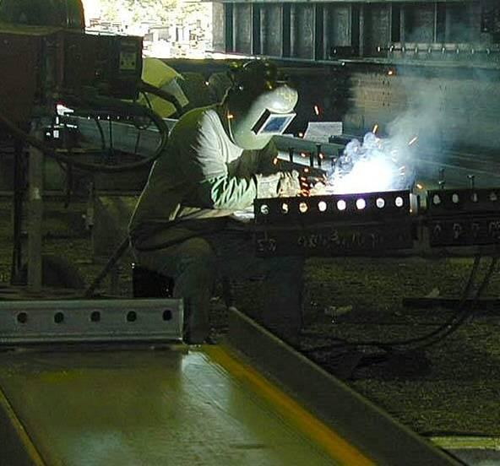
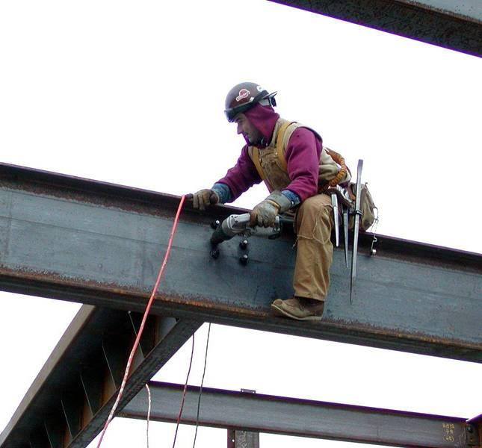
Connecting Structural Steel
A fabrication shop will have a desired fastening method suited to its equipment and fabrication methods
Field connections are typically bolted
Welding may be used for field connections where bolting cannot provide the required strength or is either impractical or undesirable
Welding is better suited to the controlled environment of a fabrication shop

Slide 8
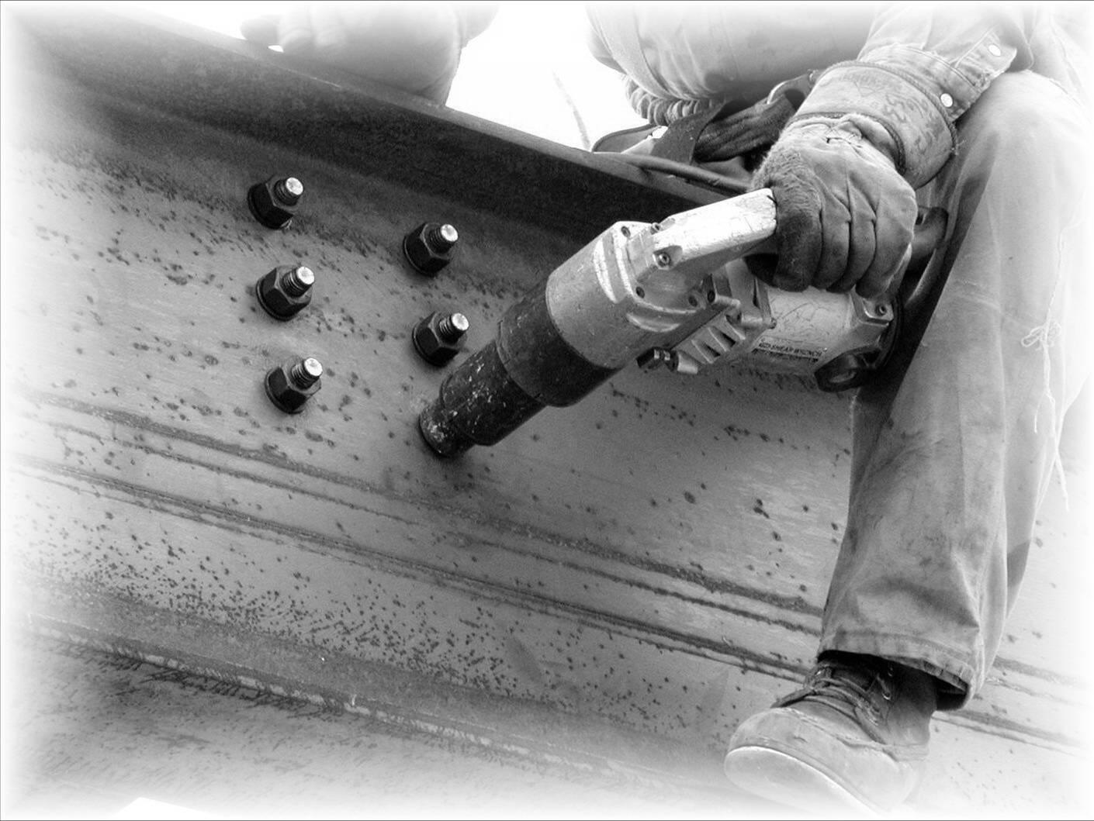
Bolting

Slide 9
Structural Bolting
The Research Council on Structural Connections (RCSC) prepares specifications and documents related to structural connections
RCSC’s Specification for Structural Joints Using High-Strength Bolts (2009) is a widely used specification which discusses joints, fasteners, limit states, installation, and inspections

Slide 10
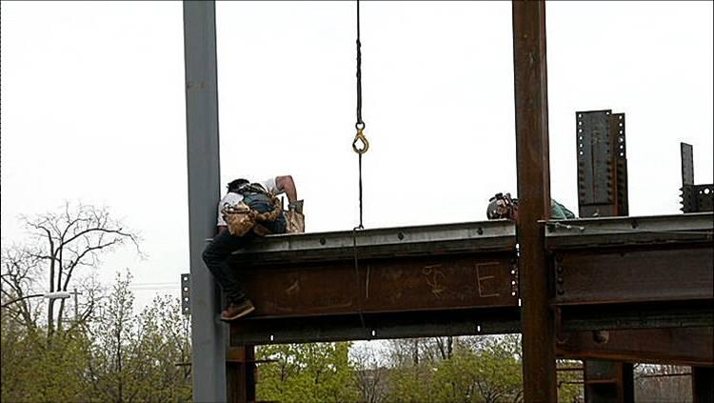
Structural Bolting
During hoisting, connectors will install a minimum of two bolts per connection
After the rest of the bolts are installed they are tightened after the structure is plumbed
A systematic pattern must be followed when tightening bolts so that a joint is drawn together and all fasteners are properly installed (SSTC 2010)

Slide 11
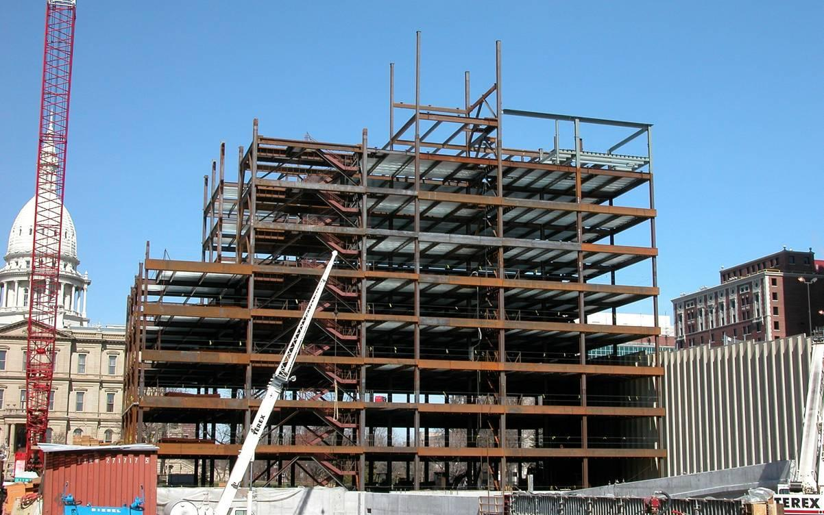
Structural Bolting
Per the Occupational Safety & Health Administration Standard 1926.754(b)(2), “At no time shall there be more than four floors or 48 feet (14.6 m), whichever is less, of unfinished bolting or welding above the foundation or uppermost permanently secured floor, except where the structural integrity is maintained as a result of the design.”

Slide 12
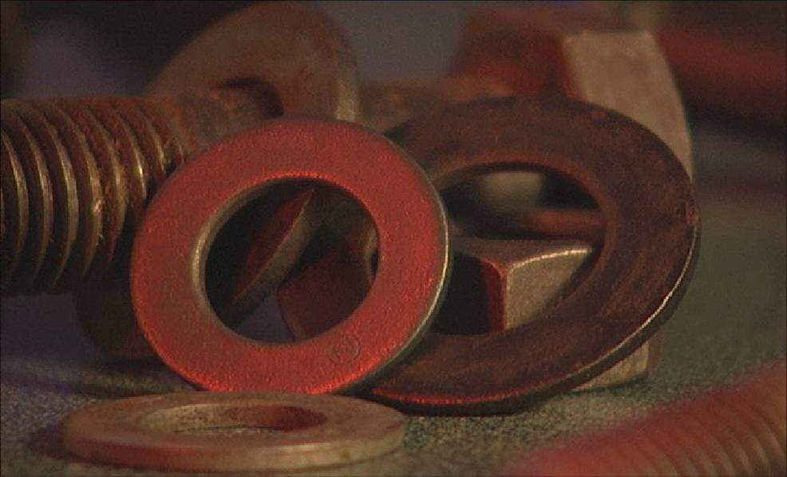
Structural Bolting
(AISC & NISD 2000)
There are many bolt types, installation methods, and joint types used in structural steel construction
When left exposed, bolts may be used to make an architectural expression

Slide 13
ASTM Bolt Types
A307 – Machine Bolts, F_{t} = 45 ksi
Group A – High Strength Bolts, F_{t} = 90 ksi
ASTM A325, A325M, F1852, A354 Grade BC, A449
Group B – High Strength Bolts, F_{t} = 113 ksi
ASTM A490, A490M, F2280, and A354 Grade BD
F_{t} = tensile strength from AISC Table J3.2
Note: F1852 and F2280 are Tension Control Bolts or “Twist-Off” Bolts which require a special tightening tool.
Notes:
Session 1
13

Slide 14
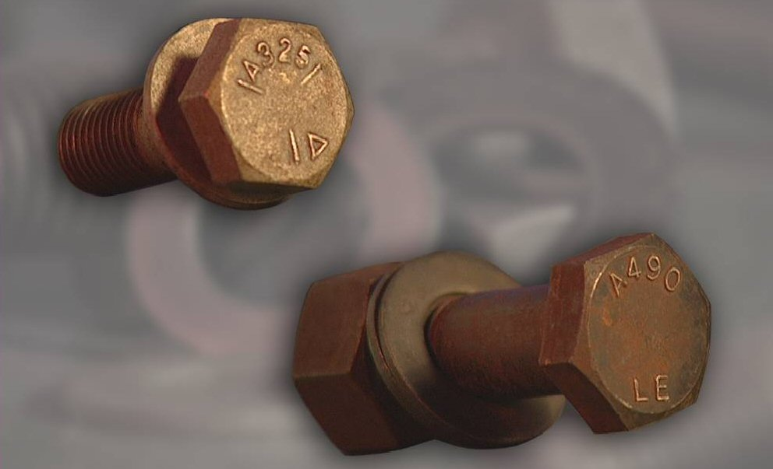
ASTM Bolt Types
A307 – Low carbon steel
Not commonly used
Only used for secondary members
A325 – High-strength medium carbon steel (above left)
Most common bolts used in building construction
A490 – High-strength heat treated steel (above right)
Cost more than A325’s, but are stronger so fewer bolts may be necessary
Note that the ASTM designation is indicated on the head of the bolts above

Slide 15
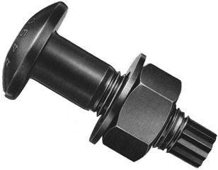
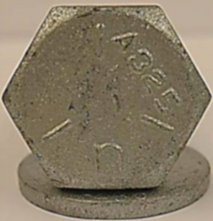
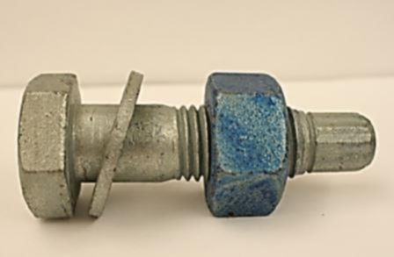
ASTM Bolt Types
Round Head
Round head (or button head) TC bolts are most common, domestically produced TC bolt.
F1852 – High-strength medium carbon steel
ASTM A325 bolt equivalent
Contains spline (above right)
F2280 – High-strength heat treated steel
ASTM A490 bolt equivalent
Contains spline (above right)
Note that the base ASTM designation (A325 or A490) for “Twist-off” or Tension Controlled (TC) bolts is required to be indicated on the head of the bolts (above left)
Hex Head

Slide 16
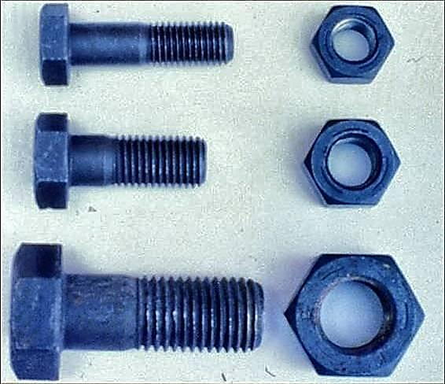
Common Bolt Sizes
High-Strength bolts are available in diameters ranging from 1/2” to 1-1/2”
The most common sizes are 3/4”, 7/8”, and 1”
High-strength bolts are commonly available in incremental lengths up to 8”

Slide 17
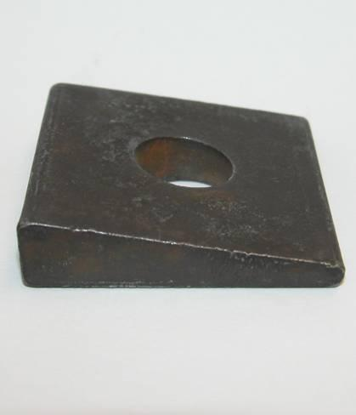
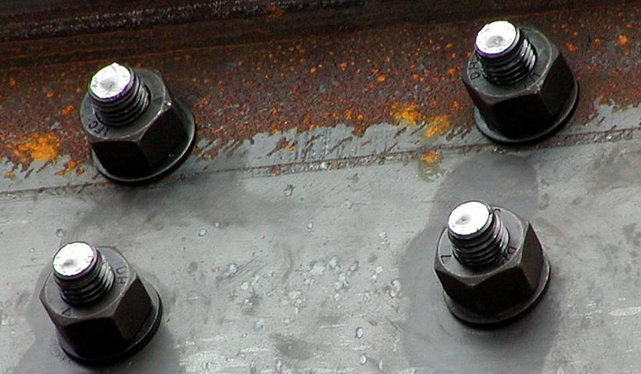
Washers
Hardened steel washers are used in many structural connections to spread pressure from the bolt tightening process over a larger area
Washers requirements are provided in Section 6 of RCSC Bolt Specification (RCSC 2009)
Washers may also be used to cover an oversized or slotted hole ASTM F436 Flat washers are most commonly used
Tapered washers (above left) are used when the surface being bolted has a sloped surface, such as the flange of a channel or an S shape
For pretensioned joints, A325 bolts require a washer under the turned element (head or nut) being turned to tighten the bolt (shown under the nut, above right)
For pretensioned joints with specified yield strength less than 40ksi, A490 and F2280 bolts require a washer under both the head and nut

Slide 18
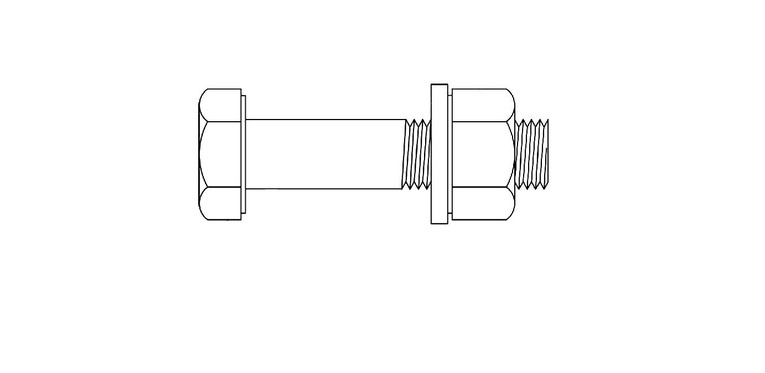
Parts of the Bolt Assembly
Grip
Washer
Washer Face
Nut
Shank
Thread
Head
Length
Grip is the distance from behind the bolt head to the back of the nut or washer
It is the sum of the thicknesses of all the parts being joined exclusive of washers
Thread length is the threaded portion of the bolt
Bolt length is the distance from behind the bolt head to the end of the bolt
Engineering Journal “Specifying Bolt Length for High-Strength Bolts” by Carter, 2nd QTR/1996

Slide 19
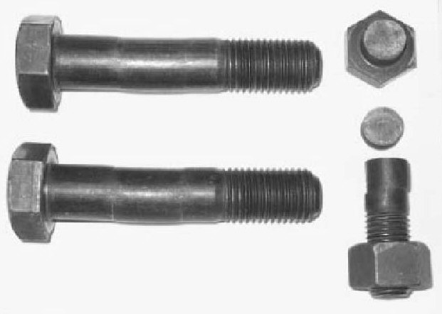
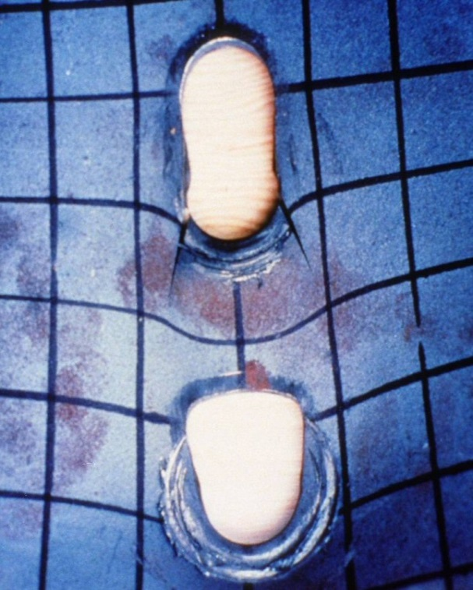
Bolts and Joint Failure Modes
Bearing Yield
Bearing Fracture
Tear Out
Bearing
Bolts in bearing are designed to meet two limit states:
Yielding, which is an inelastic deformation (above left)
Fracture, which is a failure of the joint (above left)
The material the bolt bears against is subject to bearing or tear out (above right)
Tension connections act similarly to bearing connections
Many times, connections in direct tension are reconfigured so that the bolts act in shear

Slide 20
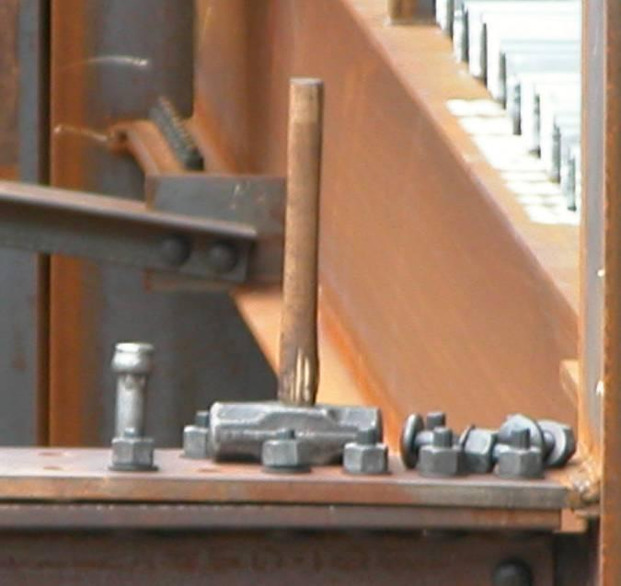
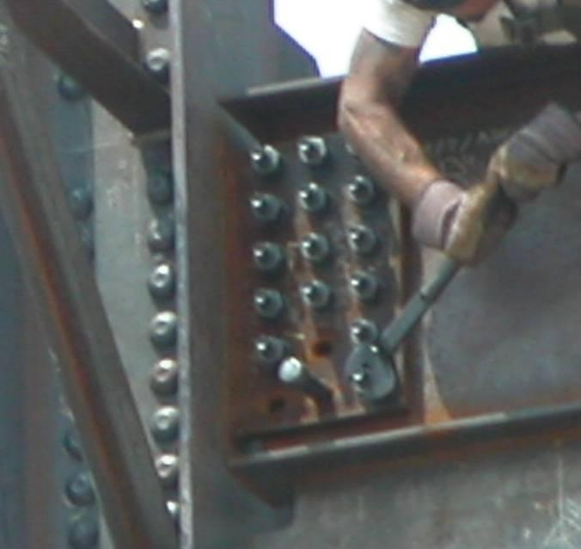
Bolted Joint Types
There two basic load transfer mechanisms in bolted joints:
Bearing
The load is transferred between members by bearing on the bolts
Slip-critical
The load is transferred between members by friction in the joint

Slide 21
Bolted Joints
Types of Connections:
(a) Bearing Type
N - threads included in shear plane
X - threads excluded from shear plane
(b) Slip Critical
SC - slip critical (friction)
Note: The designation “N”, “X” or “SC” specifies the method of design and installation of the bolt. The bolt is the same material in all cases.
Example Designations: ¾ in. A325 – N
1 in. A490 – SC
Notes:
Session 1
21

Slide 22
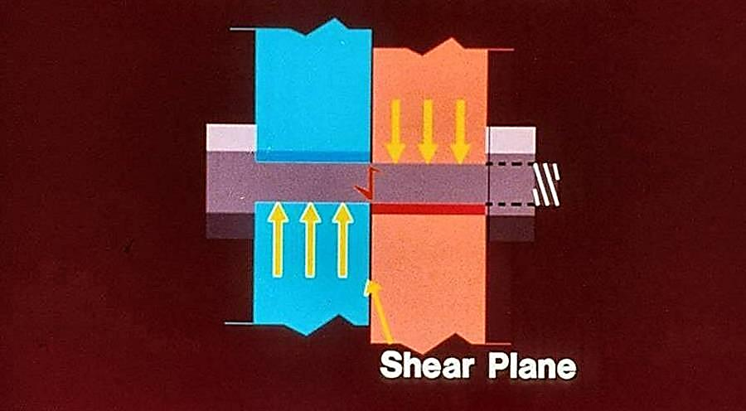
Bolts in Bearing
Bolts in bearing where the connected elements are assumed to slip into bearing against the body of the bolt
If the joint is designed as a bearing joint the load is transferred through bearing whether the bolt is installed snug-tight or pretensioned

Slide 23
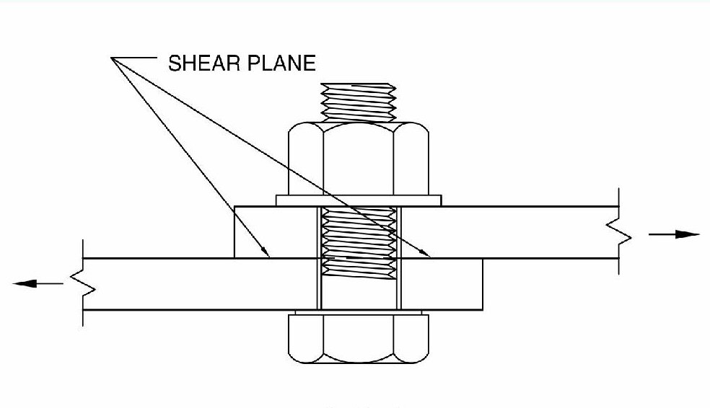
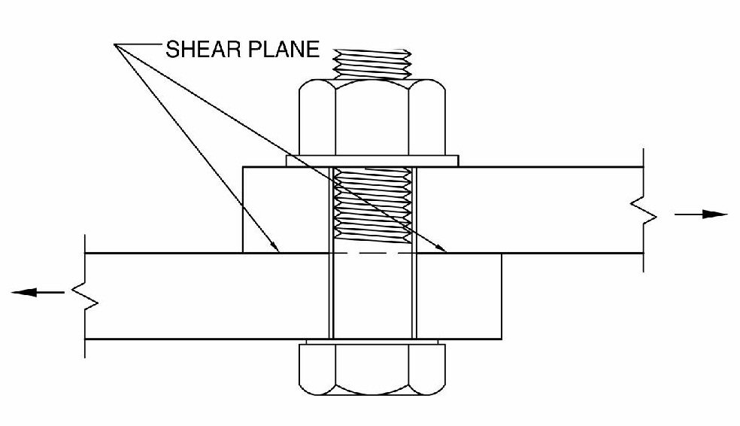
Threads in the Shear Plane
The shear plane is the plane between two or more pieces under load where the pieces tend to move parallel from each other, but in opposite directions
The threads of a bolt may either be included (N bolts) in the shear plane or excluded (X bolts) from the shear plane
The capacity of a bolt is greater with the threads excluded from the shear plane
The most commonly used bolt is an ASTM A325 3/4” bolt with the threads included in the shear plane
Threads Included In The Shear Plane
Threads Excluded From The Shear Plane

Slide 24
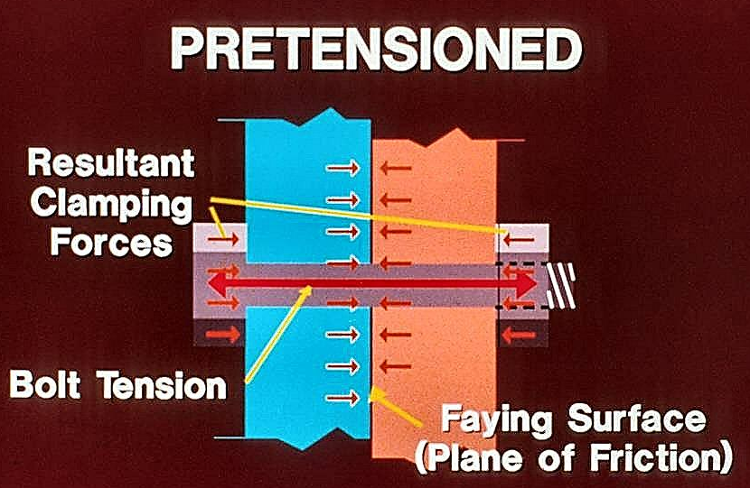
Slip-Critical Joints
In a slip-critical joint the bolts must be fully pretensioned to cause a clamping force between the connected elements
This force develops frictional resistance between the connected elements
The frictional resistance allows the joint to withstand loading without slipping into bearing against the body of the bolt, although the bolts must still be designed for bearing
The faying surfaces in slip-critical joints require special preparation

Slide 25
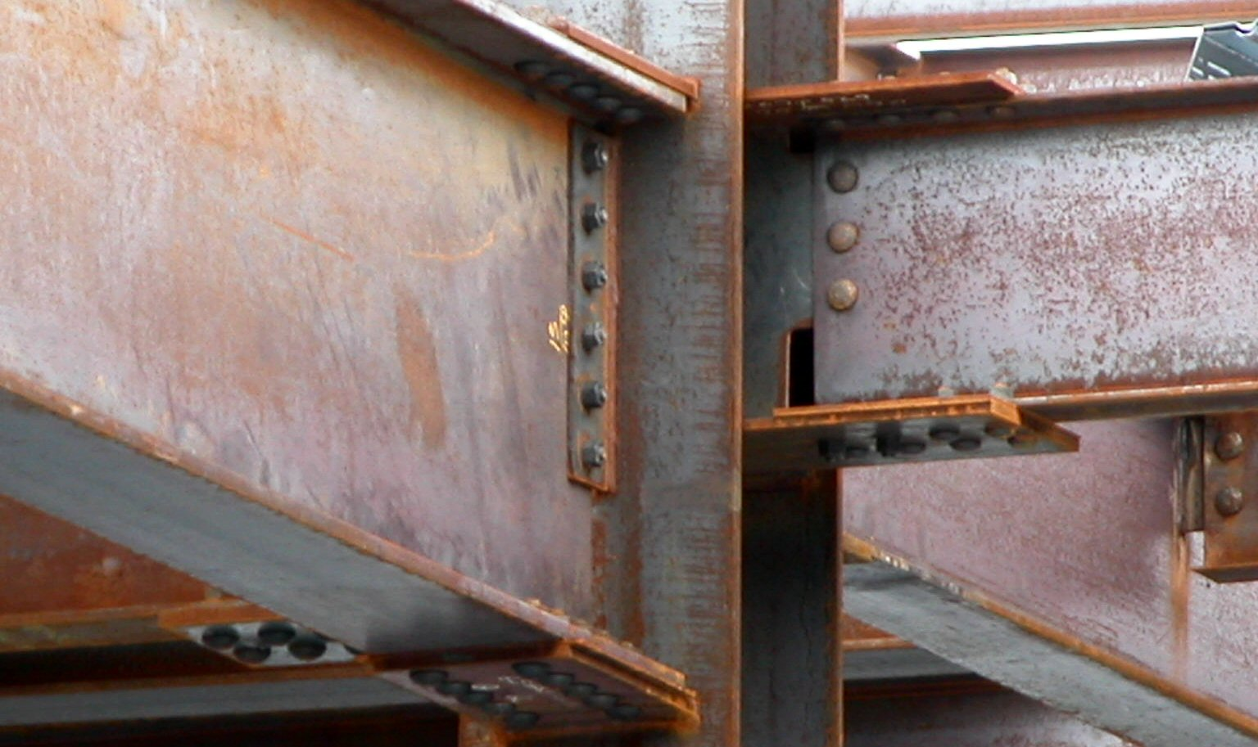
When to Use Slip-Critical Joints
Per the RCSC Specification (RCSC 2009), Slip-critical joints are only required in the following applications involving shear or combined shear and tension:
Joints that are subject to fatigue load with reversal of the loading direction
Joints that utilize oversized holes
Joints that utilize slotted holes, except those with applied load approximately normal (within 80 to 100 degrees) to the direction of the long dimension of the slot
Joints in which slip at the faying surfaces would be detrimental to the performance of the structure

Slide 26
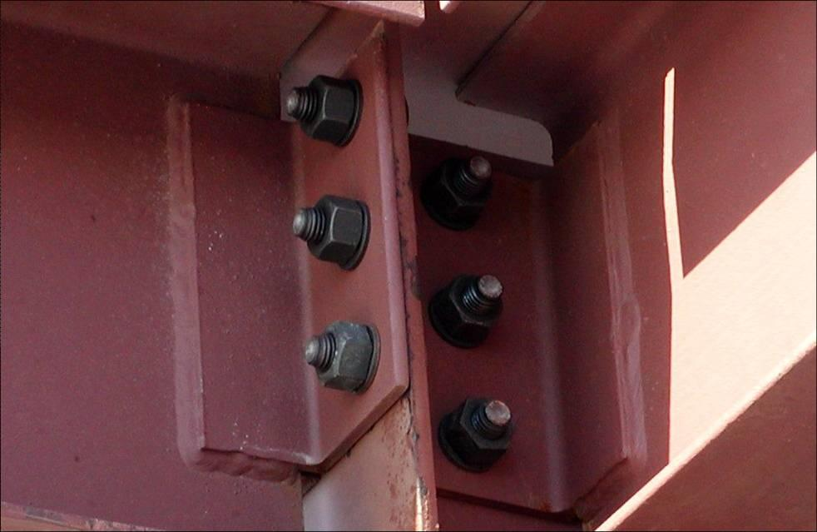
Bolt Slip (-SC Connections)
IMPORTANT:
Slip Critical Connections are expensive because of faying surface preparation, tightening and inspection requirements.
SC-Connections are not needed for typical framing connections and most moment connections and bracing connections.
SC-Connections may be needed when dynamic or vibration loads are present or may be used to control drift in frames and are required in some moment connections.
Notes:
Session 1
26

Slide 27
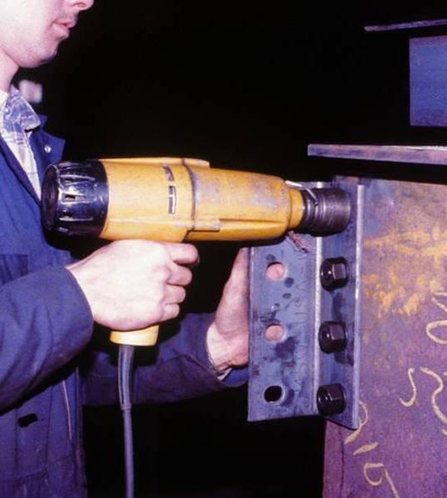
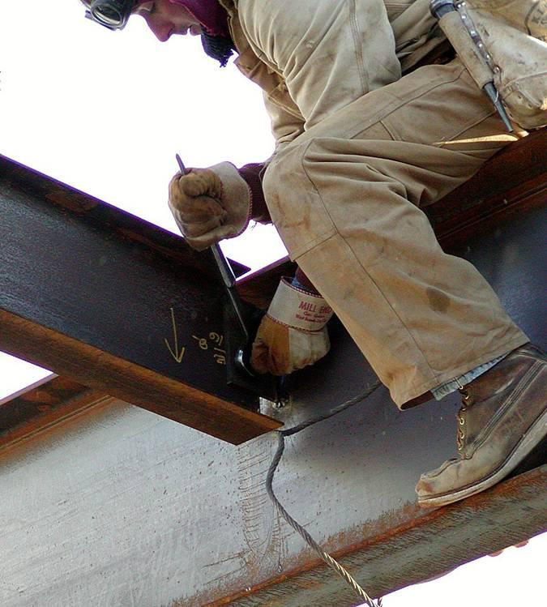
Snug-tight Installation
Snug-tight is a joint in which the bolts have been installed in accordance with RCSC Section 8.1. Snug tight is the condition that exists when all of the plies in a connection have been pulled into firm contact by the bolts in the joint and all of the bolts in the joint have been tightened sufficiently to prevent the removal of the nuts without the use of a wrench. There is no maximum tension specified for a snug-tight bolt since the process of pulling all plies into firm contact may require the bolt to be fully tensioned. (RCSC 2009)
Notes:
Add a transition slide going into the installation topic.

Slide 28
Turn-of-Nut Installation
Installation beyond snug-tight is called pretensioning
Turn-of-nut pretensioning involves several steps:
The bolt is snug-tightened
Matchmarks are placed on each nut, bolt, and steel surface in a straight line
The part not turned by the wrench is prevented from turning
The bolt is tightened with a prescribed rotation past the snug-tight condition
The specified rotation varies by diameter and length (between 1/3 and 1 turn)
(RCSC 2009)

Slide 29
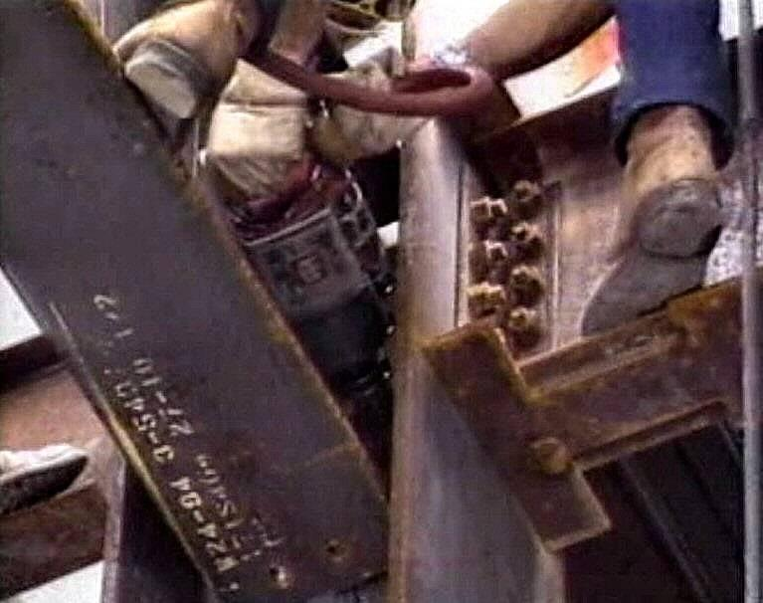
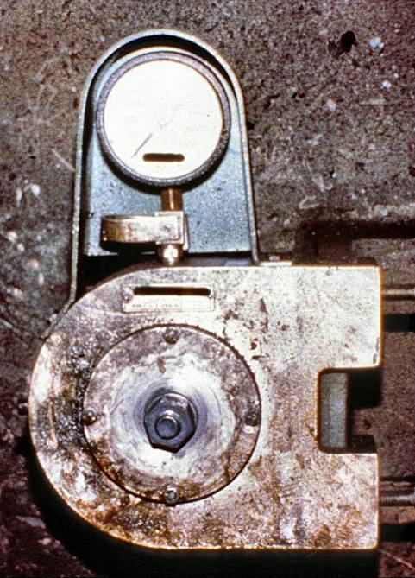
Calibrated Wrench Installation
Calibrated Wrench pretensioning uses an impact wrench (above left) to tighten the bolt to a specified tension
A Skidmore-Wilhelm calibration device (above right) is used to calibrate the impact wrench to achieve the specified tension
A sample of bolts representative of those to be used in the connections are tested to verify that the correct tension will be achieved (RCSC 2009)

Slide 30
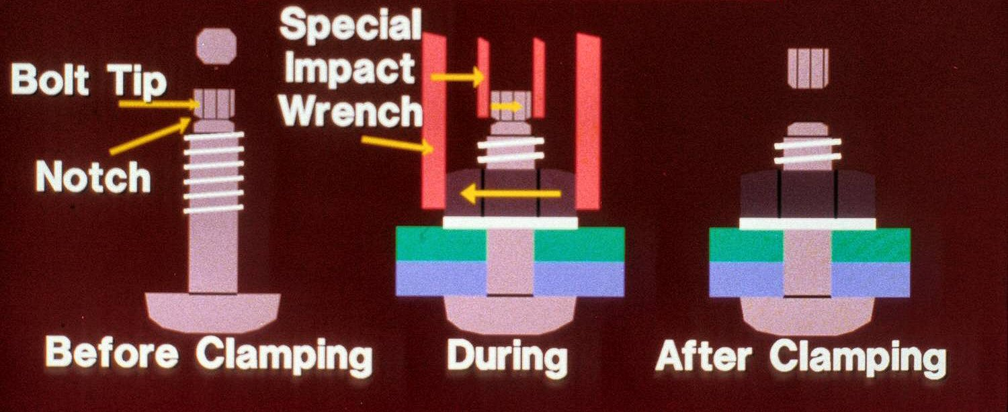
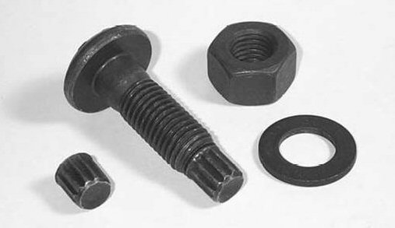
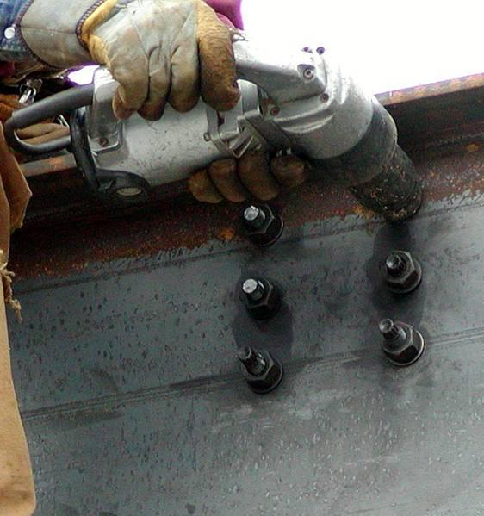
ASTM F1852 and F2280 Installation
(AISC)
F1852 and F2280 bolts are twist-off-type tension-control bolts
These bolts must be pretensioned with a twist-off-type tension-control bolt installation wrench that has two coaxial chucks
The inner chuck engages the splined end of the bolt
The outer chuck engages the nut
The two chucks turn opposite to one another to tighten the bolt
The splined end of the F1852 and F2280 bolt shears off at a specified tension
(AISC 2003)

Slide 31
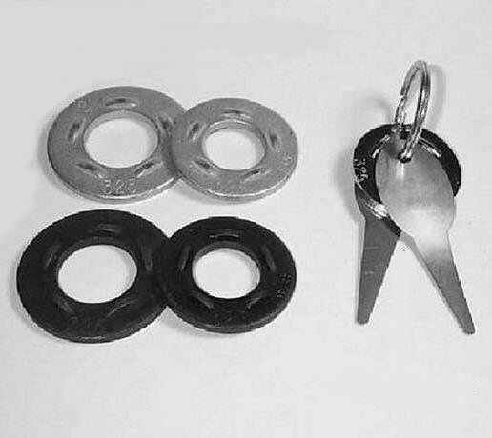
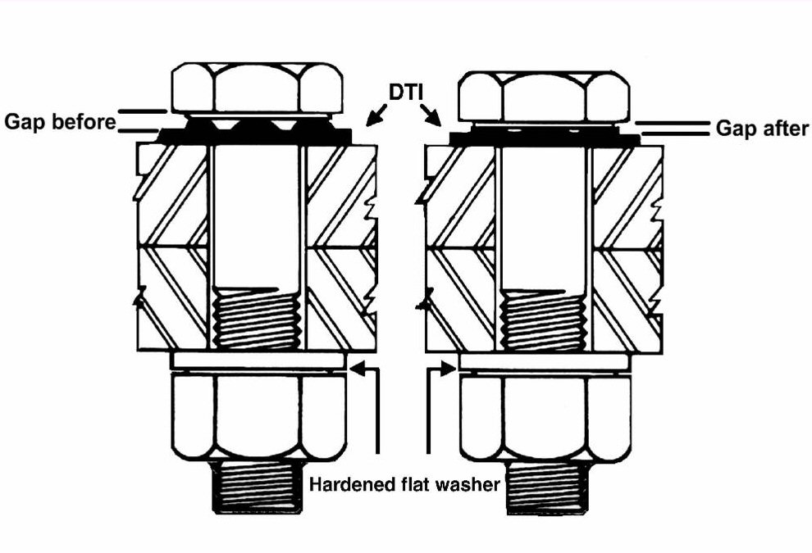
ASTM F959 Direct Tension Indicators
DTI’s
Feeler Gages
Another way to try to ensure proper pretensioning of a bolt is through the use of direct tension indicators (DTIs)
These washers have protrusions that must bear against the unturned element
As the bolt is tightened the clamping force flattens the protrusions and reduces the gap
The gap is measured with a feeler gage
When the gap reaches the specified size the bolt is properly pretensioned

Slide 32
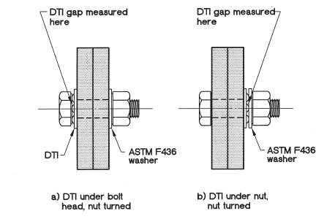
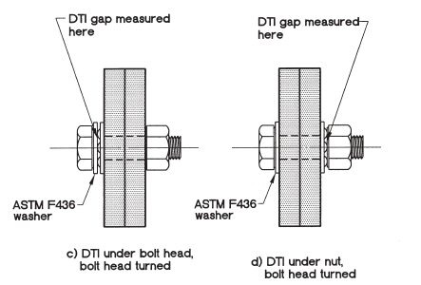
Installation of DTIs
(Adapted from Figure C-8.1 RCSC 2009)
It is essential that direct tension indicators be properly oriented in the assembly
The bolt head is stationary while the nut is turned – DTI under bolt head
The bolt head is stationary while the nut is turned – DTI under nut (washer required)
The nut is stationary while the bolt head is turned – DTI under bolt head (washer required)
The nut is stationary while the bolt head is turned – DTI under nut
(RCSC 2009)

Slide 33
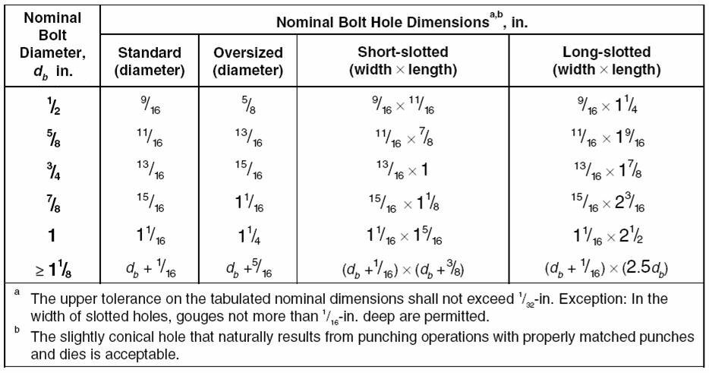
Nominal Bolt Hole Dimensions
(Table 3.1 RCSC 2009)
Bolts are installed in one of four types of holes (see table above)
Standard holes can be used anywhere
Oversized holes may only be used in slip-critical connections
Short-slotted holes are used with the slot perpendicular to the direction of stress
Long-slotted holes are primarily used when connecting to existing structures

Slide 34
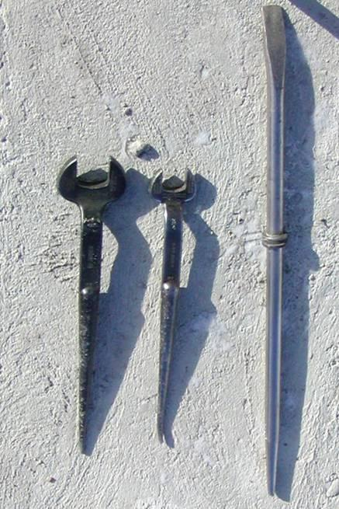
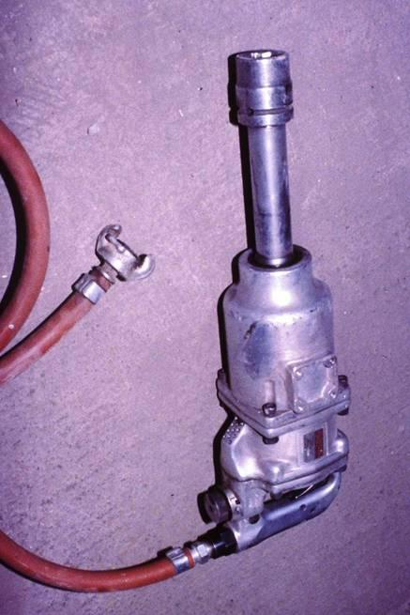
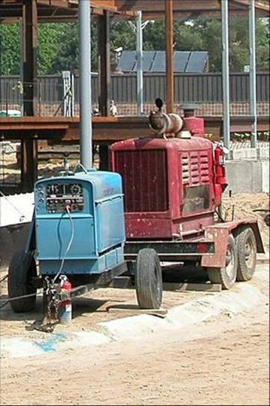
Equipment Requirements
Common tools used by Ironworkers include spud wrenches, pins, and corrections bars of various sizes (above left)
Impact wrenches will be needed for certain installations (above center)
Electricity or compressed air is required depending on the impact wrench being used
A generator as well as an air compressor may be needed (above right)

Slide 35
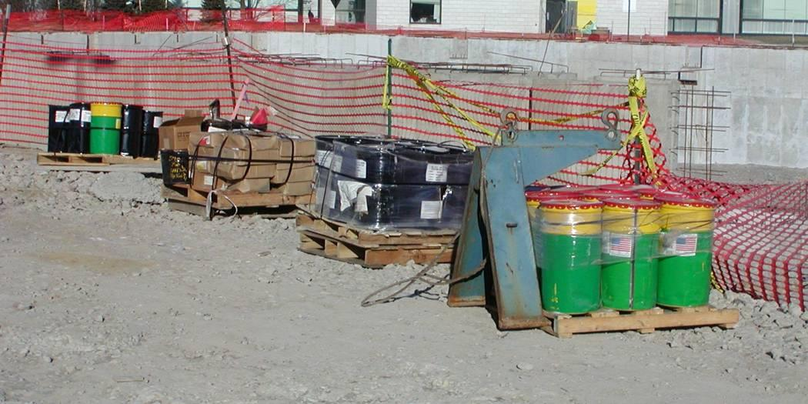
Storage of Components
Per the RCSC Specification:
Fastener components must be protected from dirt and moisture in closed containers on the jobsite
Only fasteners anticipated to be installed during the work shift are to be taken from protected storage
Protected storage is defined as the continuous protection of fastener components in closed containers in a protected shelter
Any unused fasteners must be promptly returned to protected storage

Slide 36
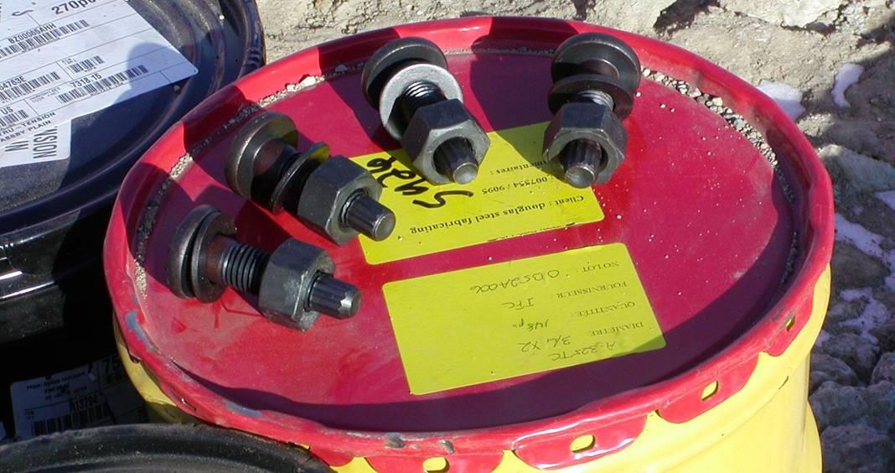
Storage of Components
The lubrication on fasteners is vital to their proper installation
A water-soluble oil is used on most black bolts
This oil is easily washed off when exposed to moisture
Fasteners that accumulate rust or dirt must be cleaned and relubricated before they may be installed
TC or “twist-off” bolts (shown above) shall not be relubricated, except by the manufacturer (RCSC 2009, SSTC 2010)

Slide 37
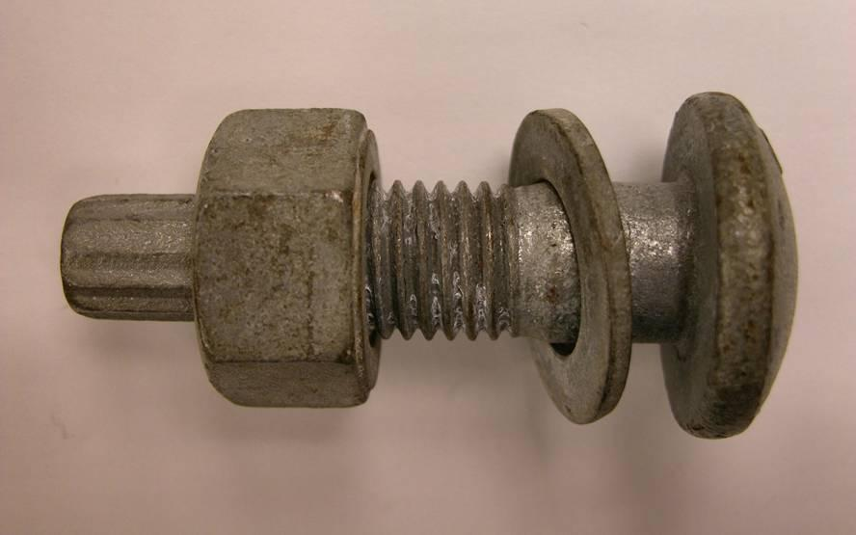
Storage of Galvanized Fasteners
Galvanized bolts and nuts (above) are provided by the supplier in a set and special storage requirements
Each bolt/nut set is pretested by the supplier and shipped together and must be kept together as an assembly
Poor thread fit may result if the bolt and nut are mismatched
The lubrication on galvanized fasteners is generally more durable than that on black bolts, but protected storage is still recommended
A490, F1852 and F2280 bolts are not allowed to be hot-dipped galvanized (ASTM F1136 Grade 3 coating is permitted) (SSTC 2010)

Slide 38
Production Lots
Production lot traceability is required by RCSC
It is necessary to keep lots separate for proper pre-installation verification testing which is required for pretensioned and slip-critical joints
Mixing bolts and nuts from different production lots is not permitted
(SSTC 2010)

Slide 39
Inspections
Per AISC Specification Chapter N
N5.6 Inspection of H.S. Bolting
Materials, Procedures and Workmanship in conformance with:
Construction Documents
RCSC Specification
Primary Method is observation of bolting operation
(AISC Seismic Provision Chapter J for seismic)

Slide 40
Inspections

Slide 41
Inspections
In addition to the erector’s quality control program, tests and inspection are specified by the Engineer of Record and/or the local building authority
A local building inspector may request that tests in addition to those specified by the Engineer of Record be performed
Snug-tightened joints require visual inspection for firm contact and proper use of washers
Pretensioned joints require pre-installation verification and routine observation of proper application
Slip-critical joints require inspection of the faying surfaces in addition to the above inspections

Slide 42
Inspections
There are several bolted connection inspections that can be performed:
Look at the bolt stick-out (above)
Stick-out is the amount the bolt extends beyond the outside surface of the nut
Positive or zero stick-out is acceptable
Negative stick-out, where the end of the bolt is inside the nut, is not acceptable

Slide 43
Inspections
Inspect the turn-of-nut matchmarks to ensure the bolts have been pretensioned
If F1852 or F2280 bolts are used, make sure the ends have been snapped off all bolts (above)
In some cases, due to insufficient clearance for the installation wrench, F1852 and F2280 bolts will be tightened by alternative methods so the ends will not be snapped off
Notes:
Picture taken from 2011 High Strength Bolts webinar

Slide 44
Bolting Cost Considerations
The types of joints used in a structure are somewhat dependent on the overall design of the structure, but these are some points to consider:
The erector may prefer certain bolt and joint types over others due to equipment requirements, experience, and installation times
Snug-tightened joints are normally the most economical bolted joints (Ruby 2003)
For pretensioned joints, Tension Controlled bolts and DTI’s are popular and can be economical
Slip-critical joints are the most costly joints, and should only be specified when necessary (Ruby 2003)

Slide 45
Welding

Slide 46
Structural Welding
Another common method for connecting structural steel is welding
Welding can be performed in the shop or in the field
Many fabrication shops prefer to weld rather than bolt
Welding in the field is avoided if possible due to welding condition requirements
There are several welding processes, types, and positions to be considered in building construction

Slide 47
Structural Welding
The American Welding Society (AWS) is a nonprofit organization with a goal to advance the science, technology and application of welding and related joining disciplines
AWS develops codes, recommended practices, and guides under strict American National Standards Institute (ANSI) procedures
(AWS 2010a)

Slide 48
Structural Welding
Welding is the process of fusing multiple pieces of metal together by heating the filler metal to a liquid state
A properly welded joint is stronger than the base metal

Slide 49
Strength of Structural Welds
(Part of Table J2.5 AISC 2010)
Welds may be loaded in shear, tension, compression, or a combination of these
Capacities for welds are given in the AISC Specification Section J2 (2010)
The strength of a weld is dependent on multiple factors, including: base metal, filler metal, type of weld, throat and weld size

Slide 50
Welding Terminology
Tack Weld (above left)
A temporary weld used to hold parts in place while more extensive, final welds are made
Continuous Weld
A weld which extends continuously from one end of a joint to the other
Stitch Weld (above right)
A series of welds of a specified length that are spaced a specified distance from each other

Slide 51
Welding Terminology
Butt
Lap
Corner
Edge
Tee
Shown above are types of structural joints which are established by positions of the connected material relative to one another
Lap, tee, and butt joints are most common

Slide 52
Welding Terminology
Fillet
Full penetration single bevel groove weld
Partial penetration single bevel groove weld
Full penetration double vee groove weld
Partial penetration single J groove weld
Plug
Weld types define the configuration of the weld and its underlying design approach
Fillet welds and groove welds are most common
Groove welds fall into two categories
Full penetration – the entire member cross-section is welded
Partial penetration – just part of the member cross-section is welded

Slide 53
Fillet Welds
Symbolic Profiles
Actual Profiles
The most commonly used weld is the fillet weld
Fillet welds are theoretically triangular in cross-section
Fillet welds join two surfaces at approximately right angles to each other in lap, tee, and corner joints

Slide 54
Groove Welds
Groove welds are specified when a fillet weld is not appropriate for the job
The configuration of the pieces may not permit fillet welding
A strength greater than that provided by a fillet weld is required
Groove welds are made in the space or groove between the two pieces being welded

Slide 55
Full Penetration Groove Welds
The bevel or “J” preparation extends over most of or the entire face of the material being joined
Complete fusion takes place
In some types of full penetration groove welds the material will be beveled from one side of the plate with a separate plate on the opposite side – called backing or a backing bar

Slide 56
Partial Penetration Groove Welds
Partial joint penetration welds are used when it is not necessary for the strength of the joint to develop the full cross section of the members being joined.

Slide 57
Welding Positions
There are four recognized welding positions:
Flat – The face of the weld is approximately horizontal and welding is performed from above the joint
Horizontal – The axis of the weld is horizontal
Vertical – The axis is approximately vertical or in the upright position
Overhead – Welding is performed from below the joint
The flat position is preferred because it is easier and more efficient to weld in this position.

Slide 58
Weld Symbols
Weld symbols are used to communicate the specific details and requirements of each weld to the welder
Weld symbols are included on fabrication and erection drawings
Horizontal Weld Line
Field Weld Symbol
Tail
Note
(Indicating this is a typical weld)
Leader Line
Length and Spacing of weld
(In Inches)
Size of weld
(In Inches)
Basic Weld Symbol
(Fillet weld symbol shown)

Slide 59
Weld Size
The size of a weld must match the size specified on the drawings
Some welds may meet the required size after a single pass of the welder
Larger weld sizes may require multiple passes to meet the size requirement
Common single pass welds include fillet welds up to and including 5/16 inch and thin plate butt welds with no preparation
Common multiple pass welds include single bevel full penetration groove welds, single bevel partial penetration groove welds, and fillet welds over 5/16 inch
The weld in the above picture is a multiple pass fillet weld

Slide 60
Weld Accessibility
Access holes are required for some welds, such as the welded flange connection shown to the right
The top access hole allows for a continuous backing bar to be placed under the top flange
The bottom access hole allows for complete access to weld the entire width of the bottom flange
A detail of a weld access hole for a welded flange connection is shown below
Extension Bar
Backing Bar
Weld Access Holes
Column
Seat Angle
(Adapted from Figure 8-13 in AISC 2011)
(Adapted from Table 1-1 in AISC 2012)

Slide 61
SMAW Welding
Shielded Metal Arc Welding (SMAW) is also known as manual, stick, or hand welding
An electric arc is produced between the end of a coated metal electrode and the steel components to be welded
The electrode is a filler metal covered with a coating
The electrode’s coating has two purposes:
It forms a gas shield to prevent impurities in the atmosphere from getting into the weld
It contains a flux that purifies the molten metal

Slide 62
GMAW Welding
Gas Metal Arc Welding (GMAW) is also known as MIG welding
It is fast and economical
A continuous wire is fed into the welding gun
The wire melts and combines with the base metal to form the weld
The molten metal is protected from the atmosphere by a gas shield which is fed through a conduit to the tip of the welding gun
This process may be automated

Slide 63
FCAW Welding
Flux Cored Arc Welding (FCAW) is similar to the GMAW process
The difference is that the filler wire has a center core which contains flux
With this process it is possible to weld with or without a shielding gas
This makes it useful for exposed conditions where a shielding gas may be affected by the wind

Slide 64
SAW Welding
Submerged Arc Welding (SAW) is usually performed by automatic or semiautomatic methods
Uses a continuously fed filler metal electrode
The weld pool is protected from the surrounding atmosphere by a blanket of granular flux fed at the welding gun
Results in a deeper weld penetration than the other process
Only flat or horizontal positions may be used

Slide 65
Welding Equipment
Equipment used for welding will vary depending on the welding process and whether the welding is being done in the shop or in the field
A Flux Cored Arc Welding machine for shop welding is pictured above left
A Shielded Metal Arc Welding machine for field welding is pictured above right

Slide 66
Weather Impacts on Welding
Welding in the field is avoided if possible due to welding condition requirements
Field welding is not to be performed while it is raining, snowing, or below 0° F
In certain ambient temperatures preheating of the material to be welded is required
AWS Code D1.1 (2010b) specifies minimum preheat and interpass temperatures, which are designed to prevent cracking

Slide 67
Welding Safety
It is important for both the welder and those working in the area around a welding process to be safety conscious
The welding arc should never be looked at with the naked eye
AWS publishes many safety and health fact sheets which are available for download at their web site: www.aws.org

Slide 68
Welding Safety
A welder should wear the proper protective gear including:
Helmet
Face shield or goggles
Gloves
Boots
Heavy fabric or leather shirt
Cuffless pants
Leather leggings

Slide 69
Welding in Existing Structures
Welding to existing structures during retrofit projects requires careful consideration of numerous factors:
Determine weldability – Identify the steel grade to establish a welding procedure
Select and design the weld – Fillet welds are preferred and avoid over welding
Surface preparation – Remove contaminants such as paint, oil, and grease
Loads during retrofit – An engineer should determine the extent to which a member will be permitted to carry loads while heating, welding, or cutting
Fire hazards – Follow all governing fire codes, regulations, and safety rules to avoid fires
For complete details see the AISC Design Guides: Rehabilitation and Retrofit Guide and Welded Connections (AISC 2002 and 2006)

Slide 70
Weld Inspections
Per AISC Specification Chapter N
N5.4 Inspection of Welding
All provision of AWS D1.1 for statically loaded structures apply.
Primary Method is observation of the welding operation, visual inspection of in-process and completed welds.
(AISC Seismic Provision Chapter J for seismic)

Slide 71
Weld Inspections
In addition to the erector’s quality control program, tests and inspections are specified by the Engineer of Record and/or the local building authority
A local building inspector may request that tests in addition to those specified by the Engineer of Record be performed
Some problems that can be found in welds include:
Lack of fusion
Porosity
Cracks
Insufficient penetration
Wrong size
Poor workmanship
There are several weld tests and inspections that are commonly used

Slide 72
Weld Inspections

Slide 73
Visual Inspection
Visual inspection is the most frequently used inspection and is the only inspection required unless the specification calls for a more stringent inspection method
Inspection is done by the welder before, during, and after welding
When independent inspection is required it should also be done before, during, and after welding
Minor problems can be identified and corrected before the weld is complete

Slide 74
Chapter N5.5 – NDT of Welded Joints
Testing Performed by QA
includes UT, MT, PT & RT
Testing Performed Per AWS D1.1
Acceptance Criteria Per AWS D1.1
Notes:
http://upload.wikimedia.org/wikipedia/commons/thumb/a/aa/GMAW.welding.af.ncs.jpg/531px-GMAW.welding.af.ncs.jpg

Slide 75
NDT Not Required for:
Fillet Welds
PJP Groove Welds
CJP groove welds in materials < ⁵/₁₆ in.
CJP groove welds in shear or compression
Welds in Risk Category I Structures
Fillet welds are designed using limited strengths, similar to PJP groove welds, and for shear stresses regardless of load application.
PJP groove welds are designed using limited design strength when in tension and therefore are not subjected to the same high stresses and subsequent crack propagation risk as CJP groove welds. PJP groove welds in compression or shear are similarly at substantially less risk of crack propagation than CJP groove welds.
Based upon AWS D1.1 limits of UT procedures for groove welds and thicknesses of 5/16 in. to 8 in.
Notes:
http://91ef69bade70f992a001-b6054e05bb416c4c4b6f3b0ef3e0f71d.r93.cf3.rackcdn.com/worker-welding-and-bright-sparks-100187944.jpg

Slide 76
Ultrasonic Inspection
Ultrasonic inspection can be used to detect flaws inside welds
High frequency sound waves are directed into the metal with a probe held at a specific angle
The flaws reflect some energy back to the probe
Flaws show up as indications on a screen (above) and are subject to interpretation by an inspector

Slide 77
UT Is Required when:
All of the following are met,
CJP groove weld, and
Subject to transverse tension loading, and
In Butt, T or Corner Joint, and
Material Thickness ≥ ⁵/₁₆ in.
NOTE: Complete-joint-penetration (CJP) groove welds loaded in tension applied transversely to their axis are assumed to develop the capacity of the smaller steel element being joined, and therefore have the highest demand for quality. The designer should provide the information necessary to determine the type of load applied.
Notes:
http://upload.wikimedia.org/wikipedia/en/thumb/7/75/Ultrasonic_pipeline_test.JPG/220px-Ultrasonic_pipeline_test.JPG

Slide 78
Magnetic Particle Inspection
Magnetic particle inspection uses powdered magnetic particles to indicate defects in magnetic materials
A magnetic field is induced in the part
The magnetic powder is attracted to and outlines cracks within the material

Slide 79
Dye Penetrant Test
Dye penetrant testing locates minute surface cracks and porosity
Dye types that may be used include:
Color contrast dye - which shows up under ordinary light
Fluorescent dye – which shows up under black light
The dye is normally applied by spraying it directly on the weld

Slide 80
Radiographic Inspection
Radiographic inspection, or X-ray, can also be used to detect flaws inside welds
Invisible rays penetrate the metal and reveal flaws on an x-ray film or fluorescent screen (above)
This is the most costly of the inspection methods

Slide 81
Welding Cost Considerations
Fillet weld is less expensive than groove weld
No special preparation
No backing required
Less volume of weld
Partial penetration groove weld is less expensive than full penetration groove weld
Labor represents the majority of the cost associated with welding

Slide 82
Bolting and Welding Scheduling Considerations
Bolting is generally a faster operation than welding
Bolting does not have the temperature and weather condition requirements that are associated with welding
Unexpected weather changes may delay welding operations

Slide 83
Structural Steel: The Material of Choice

Slide 84
References
AISC. (2011). Steel Construction Manual, Fourteenth Edition. American Institute of Steel Construction, Inc. Chicago, IL.
AISC. (2012). Seismic Provisions for Structural Steel Buildings, Second Edition. American Institute of Steel Construction, Inc. Chicago, IL.
AISC. (2002). Design Guide 15 – AISC Rehabilitation and Retrofit Guide. American Institute of Steel Construction, Inc. Chicago, IL.
AISC. (2003). Design Guide 17 – High Strength Bolts: A Primer for Structural Engineers. American Institute of Steel Construction, Inc. Chicago, IL.
AISC. (2006). Design Guide 21 – Welded Connections—A Primer for Engineers. American Institute of Steel Construction, Inc. Chicago, IL.
American Welding Society, (AWS). (2010a). American Welding Society Web Site. Available at: http://www.aws.org/. Viewed December, 2010.
American Welding Society, (AWS). (2010b). “Structural Welding Code.” ANSI/AWS D1.1-2004, Miami, FL.
Green, P. S., Sputo, T., and Veltri, P. (n.d.). Connections Teaching Toolkit – A Teaching Guide for Structural Steel Connections. American Institute of Steel Construction, Inc. Chicago, IL.
Research Council on Structural Connections, (RCSC). (2009). Specification for Structural Joints Using ASTM A325 or A490 Bolts. American Institute of Steel Construction, Inc. Chicago, IL.
Ruby, D.I. (2003) . “All About Bolts.” AISC Modern Steel Construction, May.
SSTC. (2010). Structural Bolting Handbook. Steel Structures Technology Center, Inc. Howell, MI.
Carter, C.J., 1996, “Specifying Bolt Length for High-Strength Bolts,” Engineering Journal, Vol. 33, No. 2, (2nd Qtr.), AISC, Chicago, IL.

