Slide 1
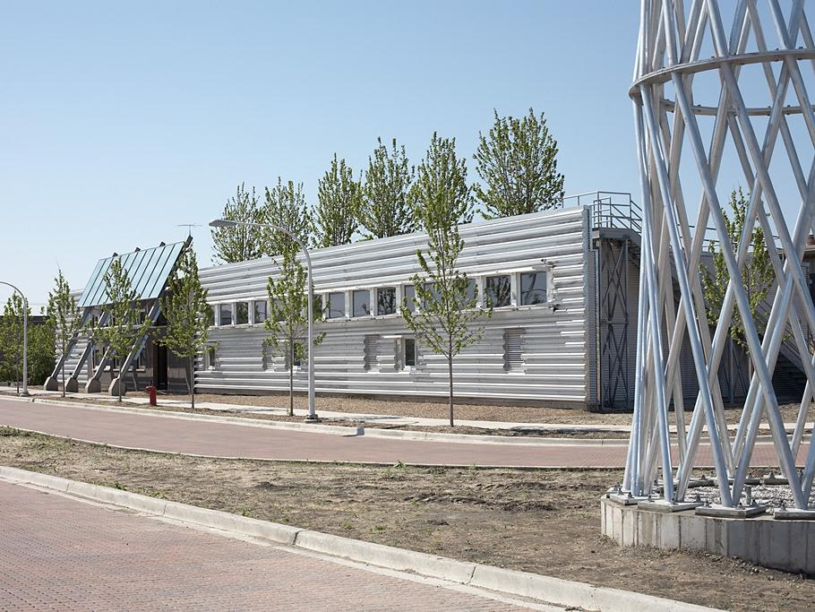

Structural Steel & Sustainability
Prepared by:
John Cross, PE, LEED AP
Vice President
American Institute of Steel Construction
Tim Mrozowski, A.I.A.
Construction Management Program
School of Planning Design and Construction
Michigan State University
Lawrence F. Kruth, PE
Vice President
Douglas Steel Fabricating Corp
March 2015

Slide 2
The information presented in this publication has been prepared in accordance with recognized engineering principles and is for general information only. While it is believed to be accurate, this information should not be used or relied upon for any specific application without competent professional examination and verification of its accuracy, suitability, and applicability by a licensed professional engineer, designer, or architect. The publication of the material contained herein is not intended as a representation or warranty on the part of the American Institute of Steel Construction or of any other person or entity named herein, that this information is suitable for any general or particular use or of freedom from infringement of any patent or patents. Anyone making use of this information assumes all liability arising from such use.
Caution must be exercised when relying upon specifications and codes developed by other bodies and incorporated by reference herein since such material may be modified or amended from time to time subsequent to the printing of this edition. The Institute bears no responsibility for such material other than to refer to it and incorporate it by reference at the time of the initial publication of this edition.

Slide 3
Course Description
The course is presented in three parts. Part 1 presents a comprehensive view of the cradle-to-cradle structural steel supply chain from a sustainability perspective. Part 2 provides an overview of the rating systems, codes and standards related to sustainable design and practice as it relates to structural steel buildings. Part 3 provides a brief introduction to the concepts and details related to thermal bridging for structural steel.
Notes:
3

Slide 4
Additional Resources
AISC provides a number of teaching aids for free downloads by students and faculty which provide background on structural steel construction.
Visit www.aisc.org and http://www.aisc.org/teachingaids to view and download these helpful resources.

Slide 5
Note to Presenter
Narrative speaker notes are available for this presentation by clicking on the “Notes Page” icon in the “View” tab.
This symbol ☞ on a slide indicates a note. You can right click your mouse to end a slide presentation and see the student/faculty notes in the bottom window pane. You can restart the slides from the current slide to restart the presentation.

Slide 6
Structural Steel & Sustainability
This presentation is Part 1 of 3 on Structural Steel & Sustainability titled Structural Steel & Sustainability 101: Introduction to Sustainability and Structural Steel. Parts 2 and 3 of the presentation are covered in the following separate presentations on the AISC Teaching Aids website:
Part 2 of 3 - Structural Steel & Sustainability 201: Codes, Standards & Rating Systems
Part 3 of 3 - Structural Steel & Sustainability 301: Structural Steel & Thermal Considerations

Slide 7
Structural Steel & Sustainability
Part 1 of 3
Introduction to Sustainability and Structural Steel
Prepared by:
John Cross, PE, LEED AP
Vice President
American Institute of Steel Construction
Tim Mrozowski, A.I.A.
Construction Management Program
School of Planning Design and Construction
Michigan State University
Lawrence F. Kruth, PE
Vice President
Douglas Steel Fabricating Corp

Slide 8
Learning Objectives
At the end of the this course, participants will be able to:
Explain each step of the cradle-to-cradle life cycle of the structural steel supply chain.
Identify the environmental impact of each step of the cradle-to-cradle life cycle of the structural steel supply chain.
Develop a preliminary approach to optimize the use of structural steel at a project level.
Notes:
8

Slide 9
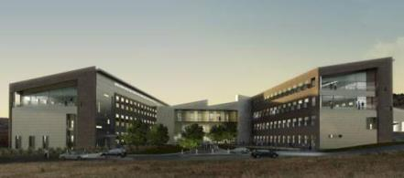
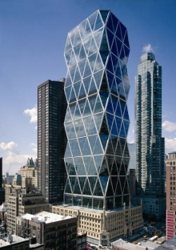
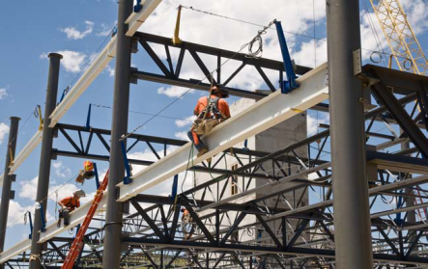
“Green” Steel
National Renewable Energy Lab – LEED Platinum
Golden, Colorado
Hearst Tower – LEED Gold
New York, New York
☞
Notes:
9
While recent proposals call for the establishment of a one-size-fits-all approach to the green certification of all types of structural materials, when it comes to structural steel, a better understanding of the supply chain can help correct wrong assumptions and provide the basis of understanding of the key issues.
From March 2012 Civil Engineering “Steel's sustainability stance” by Weisenberger (http://cenews.com/article/8772/steels-sustainability-stance)

Slide 10
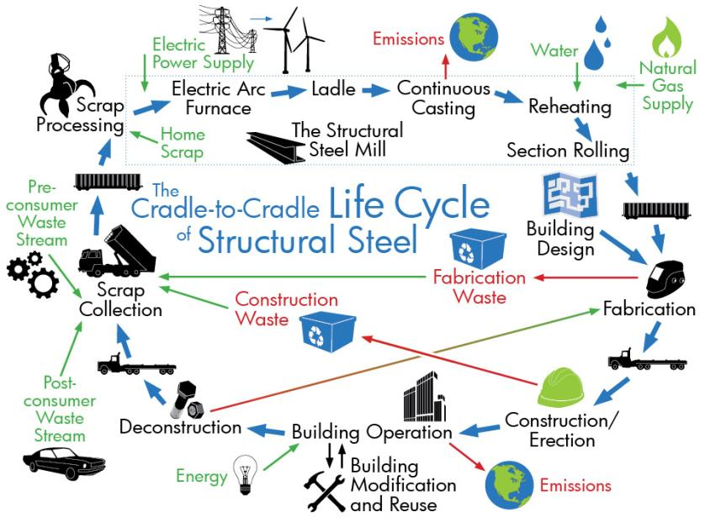
☞
Notes:
10
The supply chains for various materials are significantly different from one another. Steel for instance is manufactured from recycled materials at a limited number of mill locations. Materials that are predominantly cradle-to-cradle (multi-cycled) need to be seen from a radically different perspective than cradle-to-grave materials.

Slide 11

Gate-to-Gate
☞
Notes:
11
Structural steel has a recovery rate of 98 percent and all steel products made via the scrap-based electric arc furnace (EAF) method have an industry average recycled content of over 92 percent. (http://www.recycle-steel.org/)

Slide 12

Cradle-to-Gate
☞
Notes:
12
Cradle-to-Gate has any steel product, construction or otherwise, becoming any other steel product—a refrigerator or junk car can become a steel beam. Steel mills collect scrap in the most efficient manner from within a few hundred miles of their location. A variety of different steel products are used for the production of structural steel.
From March 2012 Civil Engineering “Steel's sustainability stance” by Weisenberger (http://cenews.com/article/8772/steels-sustainability-stance)

Slide 13
Cradle-to-Structure
☞
Notes:
13
The supply chain for domestic structural steel flows from scrap collection to scrap processing to producing mill, to warehouse to fabricator to erector to completed building. But it doesn’t end there.
From March 2012 Civil Engineering “Steel's sustainability stance” by Weisenberger (http://cenews.com/article/8772/steels-sustainability-stance)

Slide 14

Cradle-to-Cradle
☞
Notes:
14
After useful life of the structure, a building can be deconstructed and the steel sent back to scrap collection. It does not end its life in a landfill. While other products can only be recycled into a lower quality product (down-cycled), steel can be recycled over and over again and remade into new members without any loss of quality (multi-cycled). This makes it a true cradle-to-cradle building framing material.
From March 2012 Civil Engineering “Steel's sustainability stance” by Weisenberger (http://cenews.com/article/8772/steels-sustainability-stance)

Slide 15





Scrap Collection
Waste from the manufacturing process of any steel product can be recycled into structural steel.
Pre-consumer waste streams
Scrap Processing
Scrap Collection
Fabrication Waste
Post-consumer waste streams
Construction Waste
Deconstruction
☞
In 2012 an estimated 4.7 million old automobiles were recycled into new structural steel products.
Notes:
15
American structural steel is made of steel scrap collected in the most efficient manner from within a few hundred miles of their location. The supply chain for hot-rolled structural steel does not include the use of coal, coke and iron ore. Considerations relative to harvesting, mining or quarrying do not apply to hot-rolled structural steel.
From March 2012 Civil Engineering “Steel's sustainability stance” by Weisenberger (http://cenews.com/article/8772/steels-sustainability-stance)

Slide 16
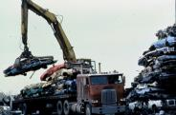
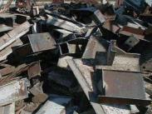
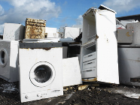
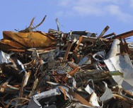
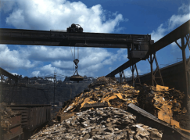
Scrap Collection
Recovery Rates:
Overall Ferrous Scrap 92%
Automotive 95%
Containers 71%
Appliances 90%
Structural Steel 98%
Reinforcing Steel 70%
Collection Radius: 80% < 400 miles
☞
Notes:
16
Over 90% of the weight of American structural steel section comes from recycled materials. VERY LITTLE structural steel ever makes it into a landfill. 98% is recovered! A five-story steel framed office building using 500 tons of American structural steel is actually made from steel that is captured at the end of its life and recycled into new American steel products. At the end of the useful life of the building, all 500 tons of structural steel can be recycled back into new steel products - with no loss of attributes. It is not “down-cycled” (made into another product like plastic bottles to carpet tile - it is truly recycled - made into new steel. This is a true cradle-to-cradle material. The steel building going up across the street could easily contain material from your old car!
View the first Made in America ad.
Read the May 2013 Modern Steel Construction article dealing with job creation in the fabricated structural steel industry titled “Behind the Scenes”.

Slide 17
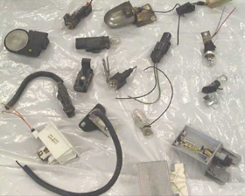
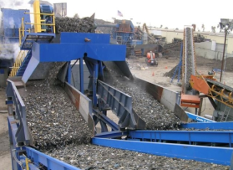
Responsible Scrap Collection
Mercury switches removed through “bounty” program.
Scrap Separation is accomplished through magnetic separators.
☞
Notes:
17
The process of scrap recovery is very efficient with a commitment to remove potential impurities. Only ferrous scrap can be separated magnetically creating a very “pure” waste stream.

Slide 18

Scrap Processing
Structural steel has an industry average recycled content of 90%.
Scrap Processing
Mills typically use scrap collected from within 400 miles of the mill. The majority of scrap is shipped by rail or barge to the mill.
Scrap Collection
☞
Notes:
18
Following collection, the steel scrap is processed by a shredding process in order to optimize it for the melting process.

Slide 19
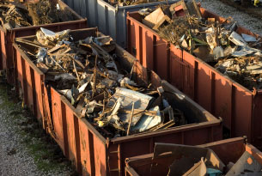

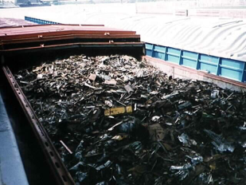

Scrap Processing
Structural Mills
☞
Steel Mills
Notes:
The map showing the green circles indicate the structural steel producers in the United States. These five locations provide 90% of the structural steel that is utilized in the US in a given year. Usually less than 10% of structural steel consumed in the US is imported. The map below on the right with red and green circles shows all the steel mills within the United States. These circles are 500 mile radius which cover 99% of the United States. For most green building rating systems, the recycled content credit is calculated by using the full post-consumer content added to 0.5 times the pre-consumer content.
Learn more at http://www.aisc.org/sustainability -- Steel Takes LEED with Recycled Content

Slide 20
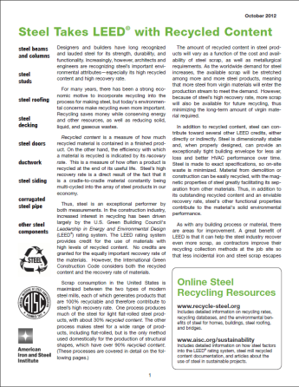
Scrap Processing
Structural Steel
Recycled Content = 89.9%
Pre-consumer = 19.3%
Post-consumer = 69.2%
Home scrap = 1.4%
LEED Basis = 79%
☞
Industry Averages
Notes:
Structural steel produced in the United States contains 93.3% recycled steel scrap. At the end of a building’s life, 98% of all structural steel is recycled back into new steel products with no loss of its physical properties. As such, structural steel isn’t just recycled but “multi-cycled,” as it can be recycled over and over and over again. It is truly a cradle-to-cradle material.
Learn more at http://www.aisc.org/sustainability -- Steel Takes LEED with Recycled Content

Slide 21
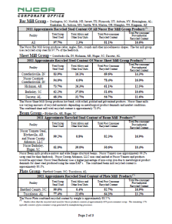
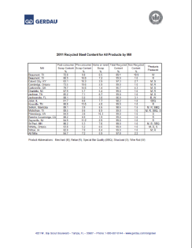
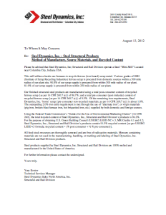
Scrap Processing
Structural Steel (EAF)
LEED 2009 Documentation
Requires Producer Letters
www.aisc.org/sustainability
☞
Producer Letters
Notes:
The following steps for collection and provision of information should satisfy the vast majority of the various requirements of projects seeking certification under LEED 2009 (the details of the calculations are not included here but are available at www.aisc.org/sustainability along with a spreadsheet template for reporting results). LEED 2009 is open for registering projects through Summer of 2016, at which time new projects will have to register to LEED V4. There are also other rating systems and standards, like Green Globes (rating system) and ASHRAE 189 (standard).
Determine the contract requirements for sustainable materials before bidding and accepting the project.
2. Verify with potential material suppliers that the required material or documentation is available.
3. Collect recycled content letters from all material suppliers.
4. Provide the general contractor with a recycled content summary list.
5. Document the regional material content of the project.
6. Provide the general contractor with a regional content summary list.
7. Include in the submissions the industry average recovery rate for structural steel materials used in building construction.
(Read more at www.modernsteel.com_Uploads_Issues_February_2013_022013_econ.pdf)

Slide 22


Mill Production
85% of the energy used in the steel making process comes from electricity. As the electric grid becomes more renewable, steel’s carbon footprint will decrease.
Electric Supply
Electric Arc Furnace
Scrap Processing
Home Scrap
The Structural Steel Mill- part 1
Productivity has increased from 12 labor hours per ton in 1980 to 0.6 hours per ton today.
Efficient melt is in range of 100 to 150 tons.
☞
Notes:
22
Three major structural steel shape producers account for over 90% of all wide‐flange shapes produced in the United States at five mill locations. The cradle-to-cradle nature of structural steel has fueled the drive for efficiency and waste utilization in structural steel mills. Recycling has progressed to the level that even the dust from the production process is captured and all dust is recycled for its ferrous content back into the final product

Slide 23
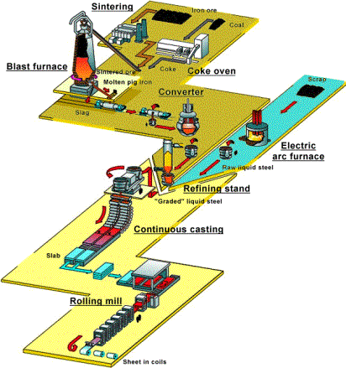
Mill Production
BOF
Basic Oxygen Furnace
30% of domestic steel
30% recycled content
EAF
Electric Arc Furnace
70% of domestic steel
90% recycled content
All hot-rolled structural steel
☞
Notes:
There are two common methods of producing steel. One method Basic Oxygen Furnace (BOF) uses iron ore, coke and roughly 30% steel scrap. The newer method Electric Arc Furnace (EAF) is completely scrap based using electricity to melt the scrap.
Hot-rolled structural shapes in the United States are produced using EAF. Steel production has increased productivity by a factor of 24 since 1980 (reduced labor hours per ton from 12 to 0.6). In addition there has been an increased in material strength by 40% since 1990 (36 ksi to 50 ksi).
http://www.aisc.org/sustainability -- Steel Takes LEED with Recycled Content

Slide 24
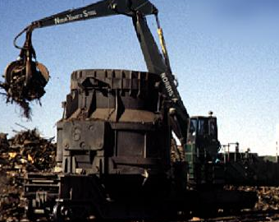
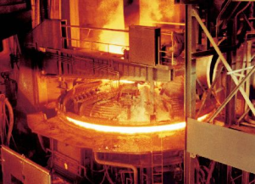
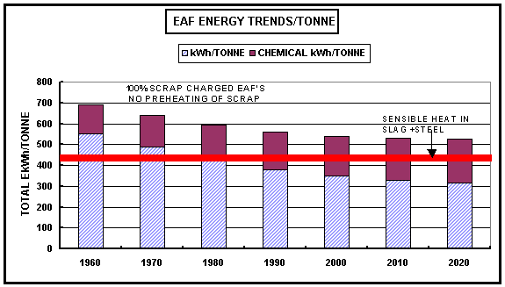
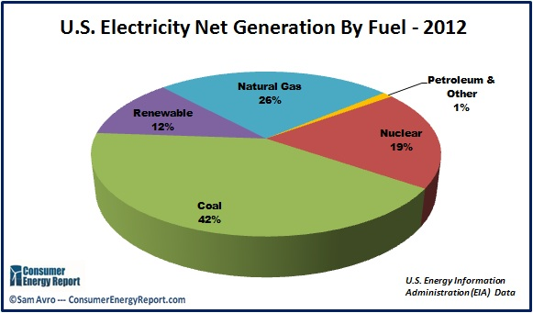
Mill Production
Scrap Selection
Electric Arc Furnace
☞
Notes:
Steel production has overall decreased its energy use by 67% since 1980. The carbon footprint (per ton) has decreased over 38% since 1990 and greenhouse gas emissions (per ton) has decreased by 45% since 1975. In addition the energy intensity (per ton) has seen a decrease by 29% since 1990.
View the first Made in America ad.
Read the white paper: Job Creation in the Fabricated Structural Steel Industry.

Slide 25



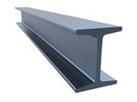
Mill Production
Emissions
The steel production process has a water recycling rate of 95%, resulting in only the consumption of only 60 gallons of water per ton of steel produced.
Greenhouse gas emissions have been reduced 38% since 1990 and overall emissions have been reduced by 67% since 1980.
Water
Natural Gas Supply
Ladle
Continuous Casting
Overall energy usage has decreased by 66% since 1980.
Reheating
Section Rolling
The Structural Steel Mill - part 2
☞
Notes:
25
The steel industry exceeded the Kyoto Protocol improvement goals by 240% and earned an EPA best industry performance designation. Water usage in the steel industry is often misunderstood. American structural mills use closed-loop water recycling systems with no discharges into the environment. The water that is consumed in the mill process is actually in the range of 60 gallons per ton of structural steel produced and this takes place through the evaporation of steam in the cooling process.
It is also important to note that 85 percent of the energy used by an EAF mill is electricity, which accounts for the majority of hot-rolled steel's carbon footprint. As a function of this energy consumption, domestically produced structural steel has approximately 0.73 tons of embodied carbon per ton produced. And, as the electrical grid becomes less carbon-based and more renewable, the environmental footprint of structural steel will decrease proportionally.
View the first Made in America ad.
Read the white paper: Job Creation in the Fabricated Structural Steel Industry.

Slide 26

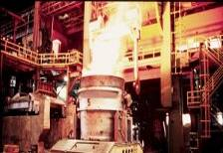
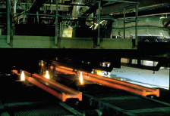
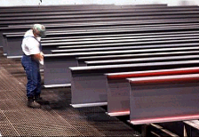
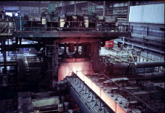
Mill Production
Electric Arc Furnace
Ladle Refining
Continuous Casting
☞
Finished Product
Rolling Mill
Notes:
The mill uses several different types of scrap, based on content and density, each with a certain percentage of iron and other residual elements: nickel, chromium, copper, tin, etc. The ladle of molten steel is refined to the proper material chemistries from the specified material designation (ASTM standard). The steel is continuously cast and rolled to the proper section dimensions based on ASTM A6. After the steel is rolled, it is inspected then stored for shipping.
Once steel is produced it becomes a permanent resource because it is 100% recyclable without loss of quality and has a potentially endless life cycle. Steel exhibits the strength, recyclability, availability, versatility and affordability for sustainable construction. While the steel industry is energy and carbon intensive, significant progress has been made to reduce steelmaking impacts.
For more information on mill production, look at the Modern Steel Construction article Keep on Rolling from February 2014.

Slide 27
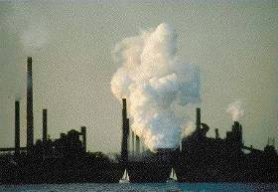
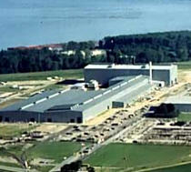
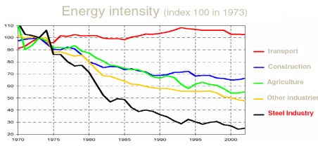
Mill Production
Then (1980)
12 labor hours/ton
Now
0.6 labor hours/ton
38% reduction in carbon footprint (since 1990)
40% higher strength (since 1990)
66% reduction in energy use (since 1980)
EPA best performance recognition
☞
Notes:
The structural steel industry has aggressively achieved energy and pollution reduction goals over the last few decades (67 percent energy use reduction since 1980 and 47 percent carbon footprint reduction since 1990). Safety is also a top priority for steel production and many measures have been taken to improve safety and quality in steel production. This has driven the structural steel producers to optimize energy efficiencies to the point where today they are approaching the theoretical limits of the structural steel production process.
The steel production process has not only reduced its environmental impact but it has also improved its efficiency. The time frame from scrap melting to cutting is around two hours: 35 minutes for the heat in the electric arc furnace, 10 minutes or so in transit, 40 minutes to create proper chemistry and 40 minutes for the casting operation. For more information on mill production, look at the Modern Steel Construction article Keep on Rolling from February 2014.

Slide 28
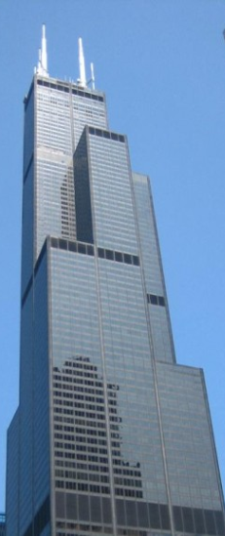
Mill Production
Then (1972)
76,000 tons of steel
20% recycled content (est)
Now (2014)
60,000 tons of steel (strength)
90% recycled content
  43,000 automobiles
  7,500 tons of curbside recycling
  10,000 tons of industrial scrap
876,000 fewer man-hours
58% smaller carbon footprint
74% less embodied energy
☞
Willis Tower, Chicago, IL
Notes:
When the Willis Tower in Chicago was built in 1972, it required 76,000 tons of structural steel which had a recycled content of 20%. If it were to be built today, it would require only 60,000 tons of structural steel. Today that steel could have a recycled content of at least 90%. To produce the steel would have totaled 876,000 fewer hours with a 58% lower carbon footprint and 74% less energy.

Slide 29
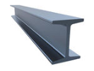

Distribution
66% of steel shipped from structural steel mills travels by rail (54%) or water (12%).
Structural steel’s material strength has increased 40% since 1990 from 36 ksi to 50 ksi further increasing steel’s high strength-to-weight ratio.
Service Center
Fabrication
  Barge = 1 ton @ 675 miles/gallon
  Rail = 1 ton @ 450 miles/gallon
  Semi-Truck = 1 ton @ 150 miles/gallon
☞
Notes:
29
As an alternative to ordering directly from the mill, fabricators can make a call to a steel service center. The fabricator purchases only the items required for each project, in the exact quantities required and to the closest dimensions possible; less waste is less cost. There are several advantages of ordering steel from a service center, but it’s their inventory that creates the most value for fabricators and manufacturers. Service centers generally have three to four months of inventory on hand at any given time so that larger-than-normal orders can be met from current inventory.
March 2006 Modern Steel Construction article AT YOUR SERVICE discusses Service Centers.

Slide 30
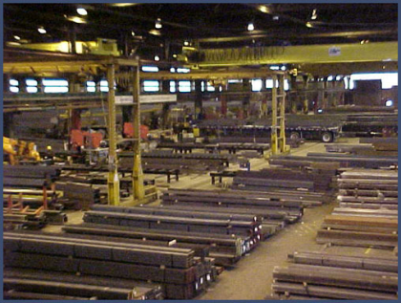
Distribution
Bulk Mill Shipments (Rail/Barge)
Structural Steel Service Center
Local Delivery to Fabricators (Truck)
☞
Notes:
30
The fabricator has two places where it can buy steel: a producing mill or a steel service center. Each has advantages and each fabricator has its own preferences and criteria for buying from either. Approximately 70% of steel in the U.S. is delivered via a steel service center. While it’s fair to say that virtually every fabricator buys steel from a service center, not every fabricator has the resources or desire to buy from a producing mill.
However, there are some advantages of a fabricator ordering from a mill directly if they can meet the minimum tonnage requirements. Shapes ordered from the mill can be ordered to exact lengths required in the finished structure down to the nearest inch. This means there will be little to no scrap material generated from the fabrication process. When ordering from Service Centers, material must be ordered at stock lengths which are in increments of 5 feet but can be cut to lengths needed. Therefore, if a piece for the finished structure is required to be 36’-5 3/8”, if the piece is ordered from the mill then it will be ordered at 36’-6” that leaves very little scrap generated in fabrication. If the piece is ordered form a Service Center, a 40’-0” piece must be ordered and can be cut to length which will have 4’-5 5/8” of scrap generated through fabrication.

Slide 31

Design
Building design and structural steel fabrication are closely integrated through the use of Building Information Modeling (BIM) and collaborative design processes resulting in materials being used more efficiently, fewer field changes and a reduced environmental impact.
MARKETING
PUBLICATIONS
REDESIGN
Fabrication
Building Design
Building Design
Careful design and detailing can avoid the challenges presented by issues such as thermal bridging.
☞
Notes:
31
From production to design, shared data and collaboration by different stakeholders are basic premises of BIM. Collaboration and sharing of data is accomplished through interoperability across a variety of platforms. Sharing of data allows for coordination of not just 3D building elements, but scheduling and maintenance data as well.
For more information look at the July 2012 Modern Steel Construction article “A Model Approach” for comparisons of the construction practices. (http://www.modernsteel.com/Uploads/Issues/July_2012/072012_model.pdf) To learn more about this project you can also visit http://www.rubyandassociates.com/results-he-proj07_12.asp.

Slide 32
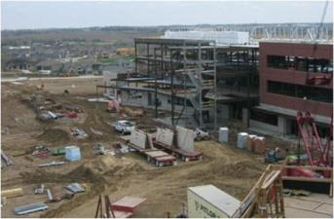

Design
Steel – Concrete Comparison
Conducted by HDR and PE International
Methodist Women’s Hospital
Omaha, NE
Steel framed
151,910 sq ft
University of Nebraska Medical Center
Omaha, NE
Concrete framed
280,000 sq ft
☞
Notes:
For comparison, AISC has conducted our own study with PE International (environmental consulting firm) and HDR (structural engineer) that compares the environmental impact of two comparable buildings, one steel and one concrete.
For more information please read the August 2010 Modern Steel Construction article “And the Winner is...” for a summary of the findings of the study. (http://www.modernsteel.com/Uploads/Issues/August_2010/082010_Aug10_Sustainability_web.pdf)

Slide 33
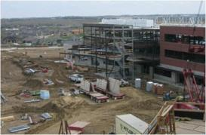

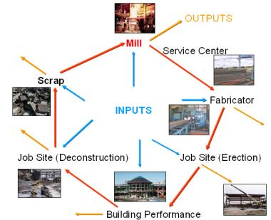
Design
Steel – Concrete Comparison
Evaluate on a impact per square foot basis
Global Warming
Acidification
Eutrophication
Smog Potential
Primary Energy Demand
☞
Notes:
While the study did conclude that the steel-framed building had a lower environmental impact in four of the five categories, it should be noted that the differences in these categories did not reach a confidence threshold of a 15% difference to conclusively recommend one material over the other.
For more information please read the August 2010 Modern Steel Construction article “And the Winner is...” for a summary of the findings of the study. (http://www.modernsteel.com/Uploads/Issues/August_2010/082010_Aug10_Sustainability_web.pdf)

Slide 34
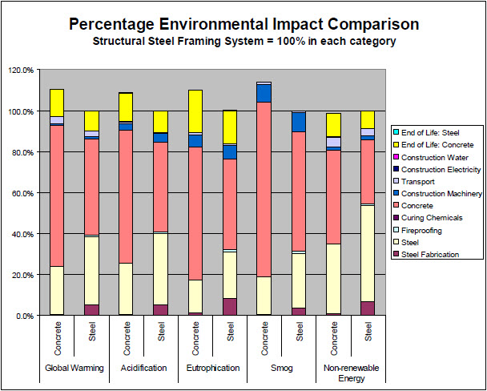
Design
☞
Notes:
34
The table above (from the study) shows how 11 different activities and materials contribute to five different measures of environmental impact, for both concrete and steel buildings. In all but one category, the structural steel building outperformed the concrete-framed building; the comparisons, expressed as percentages, are as follows:
• Global warming potential: 9% less equivalent CO2 per sq. ft
• Acidification potential : 8% less mol H+ equivalents per sq. ft
• Eutrophication potential: 9% less kg N equivalent per sq. ft
• Smog potential: 14% less kg NO equivalent per sq. ft
• Non-renewable energy primary demand: 1% more MJ per sq. ft
The only category in which steel lagged concrete was energy demand, and only by one percentage point.
For more information please read the August 2010 Modern Steel Construction article “And the Winner is...” for a summary of the findings of the study. (http://www.modernsteel.com/Uploads/Issues/August_2010/082010_Aug10_Sustainability_web.pdf)

Slide 35
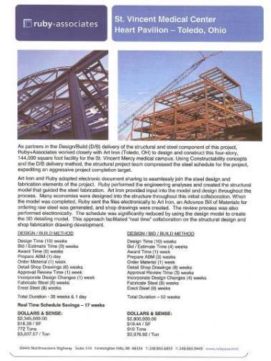
Design
Design-Bid-Build
$2.8 Million
$19.44/SF
910 tons
$3078.82/ton
964 tons CO₂
Design-Build
$2.345 Million
$16.28/SF
772 tons
$3037.57/ton
723 tons CO₂
☞
Savings of 25%
Notes:
The design-build movement has championed collaborative project development, encouraging the full early integration of every level of the design and construction industry into the project process. Significant cost and schedule savings coupled with enhanced project quality, as well as a reduction in embodied carbon dioxide, is a demonstrated result for project owners willing to embrace a project delivery methodology outside of the comfort zone of design-bid-build.
For more information look at the July 2012 Modern Steel Construction article “A Model Approach” for comparisons of the construction practices. (http://www.modernsteel.com/Uploads/Issues/July_2012/072012_model.pdf)

Slide 36


Fabrication
Fabrication Waste
Fabrication
Building Design
Steel fabrication is the manufacturing process for project specific structural steel and accounts for 40% of the cost and 70% of the labor associated with the finished product. Fabrication facilities are located throughout the US and are within 500 miles of any project location.
All fabrication waste is reused or recycled.
Construction/Erection
☞
Notes:
36
Not only in production but in fabrication there are efficiencies and savings seen. The efficiency of the fabricator contributes greatly to minimizing the overall environmental impact of structural steel. Reducing the overall scrap generated from the fabrication process can contribute to significant gains in reducing the overall environmental impact. Any scrap generated is recycled or re-used which diverts waste from the landfills.

Slide 37
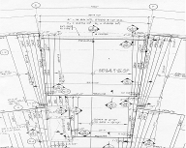
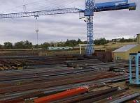
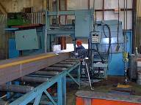
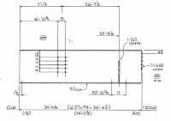
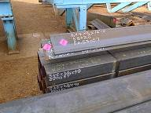
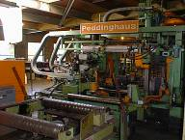
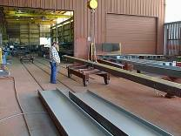
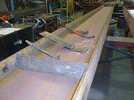
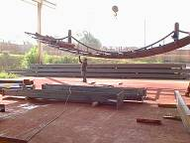
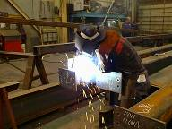
Fabrication
Detailing
Material Handling and Identification
Cutting and Drilling
☞
Painting (if required)
Fit Up
Notes:
37
The fabrication process is driven by plans developed and sealed by licensed structural engineers specifying all design aspects of the structural components of a building based on the building layout developed by an architect. Detail drawings of each piece of structural steel are produced by a steel detailer. Following a determined sequence optimized for erection in the field, the appropriate structural steel members are then cut to the proper length, drilled or punched and all additional shop work is performed on the member. When required, the member is cleaned and coated with paint or galvanized. The members are then grouped in the order in which they will be erected in the field, placed on truck for shipping and delivered to the project site. A typical fabrication project will require between 10 and 20 hours of shop time per ton of fabricated steel. Material costs account for between 30% and 35% of the final cost of the fabricated and erected structural steel. Fabrication and erection costs for structural steel vary greatly based on the type of structure being constructed, the number of pieces, local labor conditions and the complexity of the connections. Recommended Resources: A Complete Fabrication, MSC, March 2008

Slide 38
Fabrication
AISC Member Fabricator Survey
Collected Information
Steel received and fabricated
Scrap generated
Water usage
Electrical usage
Waste disposal
Fuel usage (natural gas, propane, diesel)
Welding/cutting supplies
Chemicals (paint, lubricants, cleaning agents)
Criteria
Global warming potential
Acidification potential
Eutrophication potential
Smog potential
Non-renewable energy primary demand
☞
Notes:
38
AISC conducted a study that collected information on fabrication shop and their practices. Then this information was quantified to determine the impact the average fabrication shop has on the overall environmental impact of structural steel. Above shows a list of the information collected and the criteria looked at in this study.
More information in the July 2010 Moderns Steel Construction article “The Fabricator Factor” which discusses the survey conducted by AISC. (http://www.modernsteel.com/Uploads/Issues/July_2010/072010_sustainability_web.pdf)

Slide 39
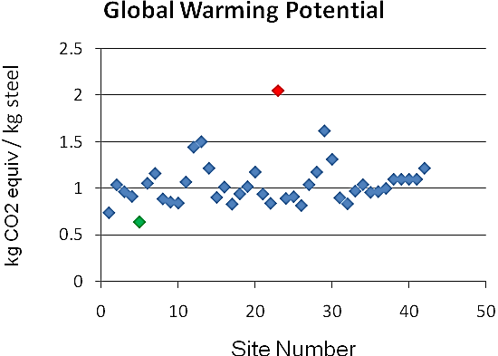
Fabrication
AISC Member Fabricator Survey
☞
Notes:
39
Once the usage data was consolidated, it was then used to evaluate the environmental impact of each of these inputs and outputs. The carbon footprint of the fabrication process is just one of several areas of impact that were determined.
The results in each category were clustered fairly tightly. Although extreme, inconsistent outliers were removed from the results pool, two marginal datasets were left in, one that generally had the highest impacts in each area and another that generally had the lowest. These “worst-case” and “best-case” examples were included to demonstrate the range of impact that the environmental performance of the steel fabricator can have on a project.
More information in the July 2010 Moderns Steel Construction article “The Fabricator Factor” which discusses the survey conducted by AISC. (http://www.modernsteel.com/Uploads/Issues/July_2010/072010_sustainability_web.pdf)

Slide 40

Fabrication
AISC Member Fabricator Survey
Fabricator impact on overall environmental impact: 18%-20%
Opportunities:
Electricity (lighting, renewable energy, efficient use of equipment)
Optimize cut lengths, reduce “waste” steel
Early involvement of fabricator
☞
Notes:
40
The study indicated that the average steel fabrication process contributes approximately 20% to the structural steel package’s portion of a steel building’s overall environmental impact—but we found that the high-impact fabricator can raise the impact by 10% to 33% and the low-impact fabricator can lower the impact by 6% to 14%, depending on the category.
More information in the July 2010 Moderns Steel Construction article “The Fabricator Factor” which discusses the survey conducted by AISC. (http://www.modernsteel.com/Uploads/Issues/July_2010/072010_sustainability_web.pdf)

Slide 41
Fabrication
 | Worst | Avg | Best
GWP | 0.261 | 0.215 | 0.193
Acidification | 0.060 | 0.052 | 0.046
Eutrophication | 5.2x10⁻⁵ | 4.5x10⁻⁵ | 4.04x10⁻⁵
Smog | 3.7x10⁻⁵ | 3.4x10⁻⁵ | 3.16x10⁻⁵
Energy | 3.71 | 2.82 | 2.42
☞
Notes:
41
In every environmental category except for eutrophication potential, electrical usage was by far the biggest contributor. Natural gas and diesel fuel (used for shipping) were the next-largest contributors in most categories, but these barely approached that of electrical usage, which was 70%-80% of total environmental impact in most categories and even more than 30% in the eutrophication category.
More information in the July 2010 Moderns Steel Construction article “The Fabricator Factor” which discusses the survey conducted by AISC. (http://www.modernsteel.com/Uploads/Issues/July_2010/072010_sustainability_web.pdf)

Slide 42


Fabrication
Legitimately Green
AISC Member Fabricator Hamilton Construction Springfield, Oregon
74.3 KW Solar Electric System
Expected cost savings:
$4,638 in first year
$280,400 (with a 3% annual energy rate inflation) lifetime savings
Environmental savings:
2,000 tons of CO₂
6,000 trees planted
209,000 gallons of gasoline
☞
Notes:
Some fabricators have taken the initiative to improve the efficiency in their shops and even make their facilities a sustainable shop. Encouraging more fabricators to improve their sustainable practices will help accomplish the structural steel industry’s long-term commitment to reducing the environmental impact of structural steel—a commitment that has resulted in a reduction of 47% in carbon emissions and a 29% reduction in energy consumption at the mill level since 1990.

Slide 43



Sustainable Fabrication
3D Modeling
Modern Fabrication Processes
CNC Data Transfer
☞
Notes:
Sustainable fabrication is improved with better technology and improved processes. The inherent power of BIM is its potential contribution to the design and construction of buildings with lower environmental impacts, whether this is in the form of energy-efficiency, the stream-lined cutting of structural steel, or for better use of fewer materials. The rationale for using BIM, therefore, goes well beyond the ease of use of the models. Other reasons include productivity gains, project controls, rapid visualization capabilities, and downstream uses of the database built into the model, such as for facility management and operations. There are many advantages to using BIM as it relates to sustainable fabrication which we will look at: faster, better, lower cost and safer.
More information in the July 2010 Moderns Steel Construction article “The Fabricator Factor” which discusses the survey conducted by AISC. (http://www.modernsteel.com/Uploads/Issues/July_2010/072010_sustainability_web.pdf)

Slide 44


Advantages: Faster, Better, Lower Cost … Safer
15+% faster delivery for customer end-use (Winter Construction)
Bi-directional data transfer: design to fab/install
Structural steel mill order: 3 weeks
Full steel package: 4 weeks
Steel erection 5 weeks ahead of schedule
Minimized multiple take-offs / re-input
elements created once and shared
HVAC install 4-5 weeks ahead of schedule – no field rework.
☞
Notes:
Fabrication of components off-site reduces on-site interferences and location availability of bottlenecks. Components can be manufactured in advance and delivered just-in-time, reducing lead times and enabling quicker erection and placement.
The times indicated in the above slide were time savings experienced on one project but similar results can be achieved with model exchange and BIM.

Slide 45


Advantages: Faster, Better, Lower Cost … Safer
3D “as-builts” before construction
Install once: Improved trades morale
No $$ change orders from building interferences
Significantly reduced field re-work
Drawings extracted directly from 3D model
Eliminated downstream conflicts (space protect zones)
  Process supplied ductwork, piping, equipment
  Equipment maintenance
  Code requirements
☞
Notes:
By using information extracted directly from the project model, digital fabrication reduces errors resulting from miscommunication of misinterpretation of design intent. The quality of fabricated components produced in controlled environments and using machine tolerances is typically better than elements constructed on-site.

Slide 46




Advantages: Faster, Better, Lower Cost … Safer
Value engineering decisions earlier using full-discipline 3D schematic model
Owner changes: < 25% of typical Design / Build project
Virtually no field overtime
0% change orders from interferences / coordination
Value stream hand-off inefficiencies minimized via direct data exchange
☞
Notes:
Fabrication of repetitive components typically brings economies of scale, enables optimized sourcing, and reduces waste and construction time. Using design models for digital fabrication creates a natural feedback loop between fabricators and designers that brings fabrication considerations forward to inform design decisions as alternatives are being evaluated.

Slide 47


Advantages: Faster, Better, Lower Cost … Safer
Increased off-site fabrication
  Reduced scrap material
  Reduced lay down areas
  Reduced number of dumpsters
Install once: rework minimized/eliminated
Better trades coordination & sequencing (less trades overlap)
Less job site clutter
Fewer (JLG) lifts in building at same time
Improved trades morale with less tear-out
Less site traffic
☞
Notes:
BIM is contributing to the safety of the construction site where the coordination and completeness of the integrated BIM data helps ensure proper scheduling and staging of construction tasks. Some general contractors and construction managers (CMs) also use BIM to reduce the amount of waste on site—an important part of sustainable construction practice—as well as loose material that can be a theft target. Additional uses include facilitating movement on the site and reducing the number of workers needed: the bottom line, fewer human and material resources to complete the tasks at hand.
With such significant health and safety benefits in both design and construction phases, it follows that overall project liability, as well as project team risk, can be reduced, too. Issues of design coordination, conflicts, and code compliance can be addressed during design, rather than construction. Projects should have less variability in cost and construction time, along with fewer claims.

Slide 48

Erection
Construction Waste
Construction/Erection
Structural steel generates virtually no onsite construction waste, and any “waste” that is generated flows back into the scrap stream instead of a landfill.
Steel is fabricated offsite to strict tolerances and can be erected quickly in the field meaning fewer workers on the job site, safer working conditions, shorter construction schedules a reduced emissions from construction equipment.
☞
Notes:
48
Green building rating systems consider site waste - steel buildings lend themselves to much less site waste than other materials as they are fabricated off site and erected on site. Further, green building ratings systems are increasingly giving an overall waste limit - instead of diverting 50 or 75% of site waste, they say you can only have 2.5 psf of waste. This is favorable to steel structures which have no on-site forming, curing, rebar placement, etc.
Sustainable site development, energy efficient building design and materials, renewable energy sources and technologies, and the use of recyclable and locally available materials are all sustainable measures implemented by structural steel erectors. Sustainability and safety influence the erection plan which contributes to the overall success on the construction project. The elimination of on-site waste from using structural steel is a major advantage over other framing system materials.

Slide 49


Erection
Not just WHAT, but HOW we build
Waste diversion
Waste minimization
Minimization of on-site labor
Reduction of on-site emissions
Emphasis on offsite fabrication
Integration of modularization
Implementation of lean construction
Safety and training
☞
Notes:
Sustainable materials is only part of the equation for a more sustainable construction project. Sustainable erection practices also play a role is green construction and buildings.

Slide 50

Operational Impacts
Building Operation
Energy
Emissions
Steel framing allows easy integration of mechanical systems resulting in low floor-to-floor heights, less building volume and lower energy consumption. Steel framing allows for large window areas resulting in plentiful natural lighting, higher occupant comfort and reduced electrical consumption.
The thermal capacity of a structural steel building has been shown to be comparable to that of buildings constructed with alternative framing system materials.
☞
Notes:
50
Benefits of structural steel including low floor-to-floor heights not only has the added advantage of less material use but it also contributes to a smaller energy consumption and less emissions.

Slide 51


What is thermal capacity?
Thermal capacity is analogous to a flywheel. It allows a building to store excess thermal energy and then releases it over time.
☞
Notes:
51
Excess heat (solar mainly) is absorbed and stored in the building envelop during the day and removed by overnight cooling. The amount of heat which the structure can absorb is the thermal capacity.

Slide 52

Overcoming the Myth of Thermal Mass
The Myth: The more mass the greater the thermal capacity of the building.
The Fact: Mass is only one factor in developing the thermal capacity of a building.
☞
Notes:
52
The amount of passive cooling that can be provided by buildings with relatively light steel frames is very similar to that which can be provided by far heavier structures. Other factors such as building occupancy patterns and insulation levels have a much greater influence on energy consumption. The illustration of a football lineman is explaining that it is not solely the weight of a football player that determines his effectiveness, but also his speed and strength.

Slide 53
Mass versus Capacity
Thermal Mass or Thermal Capacity?
The measure of thermal mass is a material’s ability to absorb, store and release heat. It is measured by the amount of thermal energy stored per unit of mass.
The measure of thermal capacity is a building’s ability to absorb, store and release heat. It is measured by the amount of thermal energy stored per unit of building volume.
☞
Notes:
53
Lightweight building systems have long been considered to be less energy efficient in this regard than mass-intensive systems. That assumption was challenged by a Ryerson University research study conducted by Dr. Mark Gorgolewski (see “Framing Systems and Thermal Mass,” in the January 2007 issue of Modern Steel Construction) that demonstrated that the quantity of mass was not the only factor in determining the overall thermal efficiency of a building system.

Slide 54

How Much Mass Is Required?
Typically the mass of concrete in the floor and wall systems are adequate to develop the necessary thermal capacity of the building
Steel-framed, zero net-energy building
National Renewable Energy Laboratory
Golden, Colorado
☞
Notes:
54
Over a typical 24 hour cycle, the maximum value of admittance for a slab exposed only from underneath may be achieved with only 3-4 in of concrete. This means that, where heating and cooling takes place over a daily cycle, a floor thickness of 4 in (typical of steel composite construction) will provide the maximum amount of energy storage possible. If more mass is provided, it will not be utilized and is a waste. The structure picture above is a steel-framed building that achieved zero net-energy meaning that the building has a total amount of energy used on an annual basis that is roughly equal to the amount of renewable energy created on the site.

Slide 55
The Thickness of the Material
The absorption and release of heat energy takes place on a cyclical rather than absolute basis. The rate of heat energy penetration into the material is just as important as the mass of the material. The effective thermal mass of a material is limited by the depth to which the thermal energy can penetrate the material in a typical 24 hour cycle.
For concrete the limiting thickness is 4 inches from the exposed surface.
4 inches
12 inch
thickness
8 inches effective
4 inches
4 inches
☞
Notes:
55
The thickness, placement and exposure of building materials with high thermal mass all impact the material’s contribution to the building’s energy efficiency. Structural steel framed buildings can contain adequate quantities of high thermal mass materials to provide equivalent energy savings to high-mass buildings.
To learn more visit: www.modernsteel.com/Uploads/Issues/March_2012/032012_thermal_bridging_March_insert

Slide 56

The Exposed Surface of the Material
The corollary is that increasing the exposed surface area increases the thermal efficiency of the material.
Steel decking has a high rate of thermal transmission and does not adversely impact the energy transfer.
☞
Notes:
56
The impact of thermal mass in the floors can be significant, with about 5% reduction in heating energy use just by using 4 in concrete floors in place of lightweight floor systems. There is a point of diminishing return after about 4 in, as energy use is only slightly reduced when the slab thickness is doubled. Since most steel-framed buildings contain concrete slabs (with 4 in being common), they already provide thermal capacity and may not require specific mass components in the exterior walls.
Further gain in thermal capacity can be accomplished by providing a greater amount of surface area through which thermal energy can be transmitted.

Slide 57


Adaptability
Building Operation
Building Modification and Reuse
Steel framing systems are easily adaptable when it comes to building expansion or adaptive reuse projects.
☞
Ottawa Street Power Plant
Lansing, MI
Notes:
57
A building’s life-cycle environmental impact includes both operational and embodied components. Operational impacts are those such as energy consumption that occur during use, while embodied impacts are mostly due to the production and installation of the building’s materials. An example of an embodied impact is the pollution released during the extraction, manufacture, and installation of a building component. The longer a building remains in service, the smaller the embodied impacts are per year of service. Therefore, efforts to minimize embodied impacts must also include strategies to increase service life. One method is through adaptability of existing structures.

Slide 58



Adaptability
Ottawa Street Power Plant
Lansing, Michigan
Accident Fund Insurance
Lansing, Michigan
☞
Notes:
58
Material sustainability depends upon "closing the materials loop," meaning the material life-cycle is circular (use → collect → process → reuse) rather than linear (extract →manufacture → use → discard). Deconstruction, a demolition method where a structure is carefully and methodically disassembled so as to salvage as many components as possible, is a key step in this circular life-cycle. Adaptability or re-use of an existing structure are also sustainable methods to minimize the amount embodied energy use. This structure was adapted from being a power plant to an office building.

Slide 59
Deconstruction
Structural steel has an industry average recycling rate of 98%.
Scrap Collection
Fabrication
Beams and columns removed from a building can be re-fabricated for use in new structures without having to be melted and rolled.
Deconstruction
Building Operation
☞
Notes:
59
Durability and adaptability may never be required for buildings that, due to factors such as neighborhood changes, have a short life; however virtually all buildings will eventually be replaced or removed, so facilitating deconstruction and material reuse will almost certainly be useful. Designing for deconstruction increases the value of a building for two reasons: the building will be easier to modify and improve during its useful life; and, at the end of its life the salvage value of its constituent materials will be higher. This benefit is seen through the use of structural steel. The materials will have been selected for their reusability and connected together so as to be easily separable for reuse.

Slide 60


Deconstruction
☞
Notes:
60
AISC has many articles and information on the benefits of structural steel including articles on sustainability and deconstruction. One such brochure is on the slide. Another is a Modern Steel Construction article: June 2004 Design for Deconstruction (http://www.modernsteel.com/Uploads/Issues/June_2004/30730_dfd.pdf).

Slide 61
Resources
“A Complete Fabrication,” Modern Steel Construction March 2008 Issue.
(http://www.modernsteel.com/Uploads/Issues/March_2008/032008_30775_cives_web.pdf)
“A Model Approach,” Modern Steel Construction July 2012 Issue. (http://www.modernsteel.com/Uploads/Issues/July_2012/072012_model.pdf)
AISC Sustainability website www.aisc.org/sustainability
ANSI/GBI 01-2010: Green Building Assessment Protocol for Commercial Buildings (http://www.thegbi.org/about-gbi/ANSI-GBI-standards-document.shtml)
“AT YOUR SERVICE,” Modern Steel Construction August 2006 Issue.
(http://msc.aisc.org/globalassets/modern-steel/archives/2006/08/2006v08_at_your_service.pdf)
Cross, John, “Job Creation in the Fabricated Structural Steel Industry,” AISC White paper
(http://www.aisc.org/WorkArea/linkit.aspx?LinkIdentifier=id&ItemID=33666)
“Design for Deconstruction,” Modern Steel Construction June 2004 Issue. (http://www.modernsteel.com/Uploads/Issues/June_2004/30730_dfd.pdf)

Slide 62
Resources
"Green Building Systems: A Comparison of the LEED and Green Globes Systems in the U.S." (http://www.thegbi.org/gbi/Green_Building_Rating_UofM.pdf)
“Keep on Rolling,” Modern Steel Construction February 2014 Issue.
(http://www.modernsteel.com/Uploads/Issues/February_2014/022014_Keep_on.pdf)
Steel Takes LEED with Recycled Content
“The Fabricator Factor,” Modern Steel Construction July 2010 Issue. (http://www.modernsteel.com/Uploads/Issues/July_2010/072010_sustainability_web.pdf)
“Thermal Bridging Solutions,” Modern Steel Construction March 2012 Issue. (www.modernsteel.com/Uploads/Issues/March_2012/032012_thermal_bridging_March_insert)
Weisenberger, Geoff, “Steel's sustainability stance” Civil Engineering, March 2012. (http://cenews.com/article/8772/steels-sustainability-stance)

